Slide 1
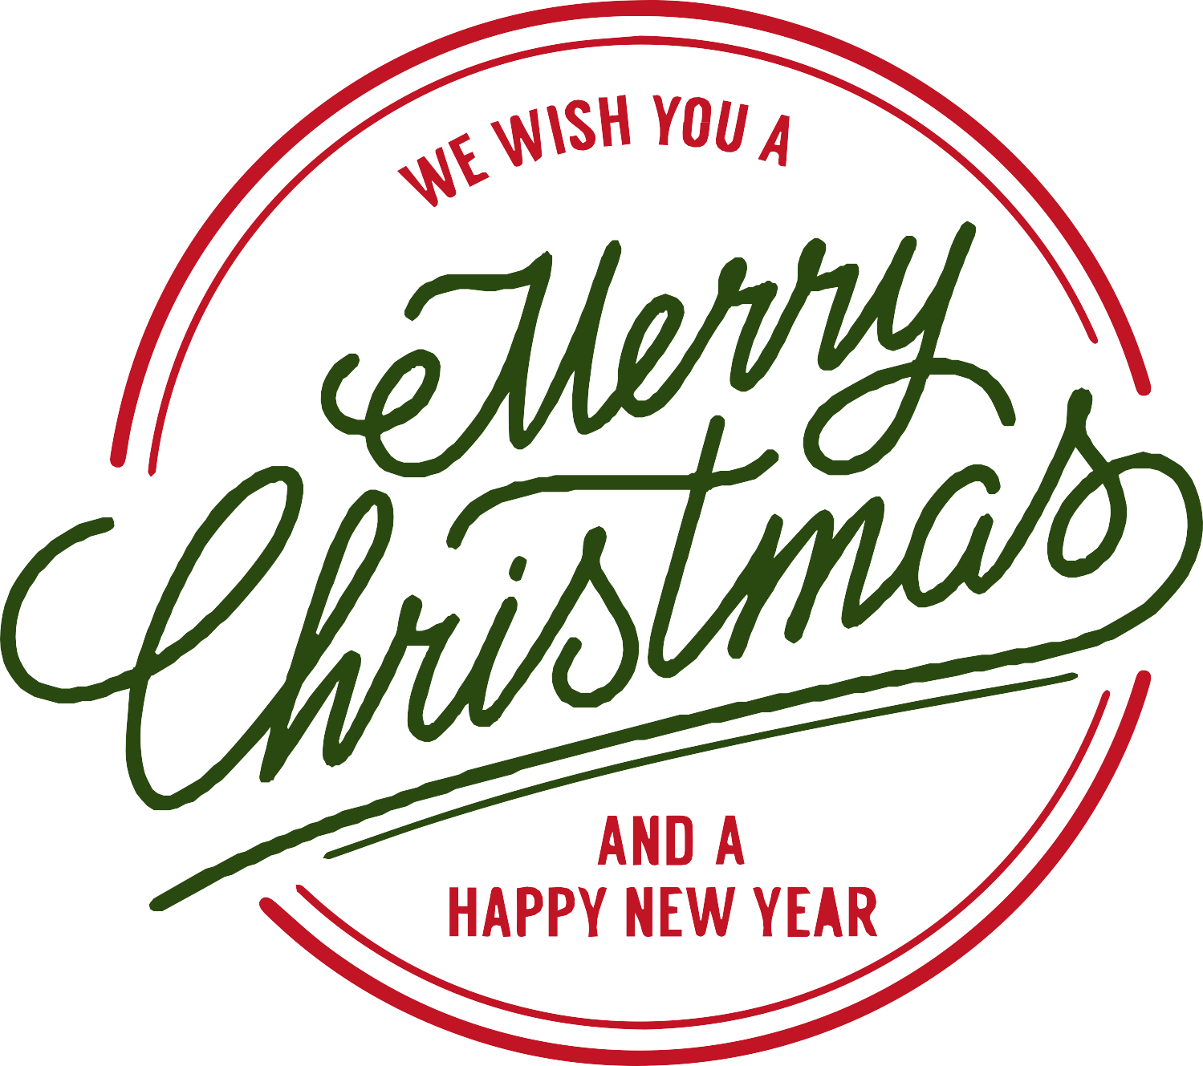
2021
GIFT CATALOGUE

Slide 2
Queridos todos:
Esperamos que se encuentren bien.
Les preparamos este catálogo de regalitos súper lindos y a tremendos precios. Quedan pocos de cada uno, así es que como dicen: “first come, first served”.
Ojalá encuentren alguno que les resuelva su listita o algo para ustedes.
Nos escriben a info@allegrogallery.com o al 6671-6967 con los escogidos, les confirmamos si quedan disponibles y coordinamos la entrega.
Cuídense mucho,
Mirie, Jani y Vale
El equipo de Allegro

Slide 3
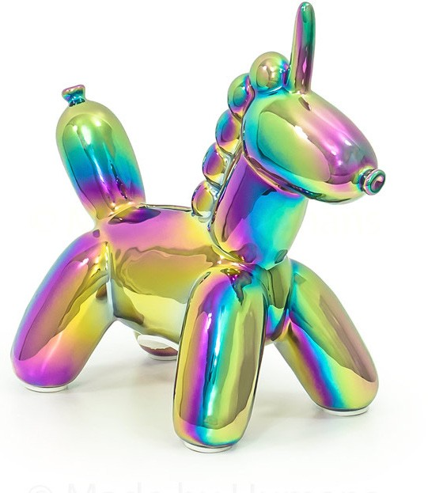
Christmas Gift Ideas
Catalogue 2021
Ballon Money Bank
SMALL UNICORN - RAINBOW
Increase your savings with this adorable baby unicorn piggy bank.
Hi-Gloss, electroplated ceramic
Size: 7.5″ L x 3.3″ W x 6.4″ H
Reg Price : $39.95
NOW: $22.95
Cantidad disponible: 2

Slide 4
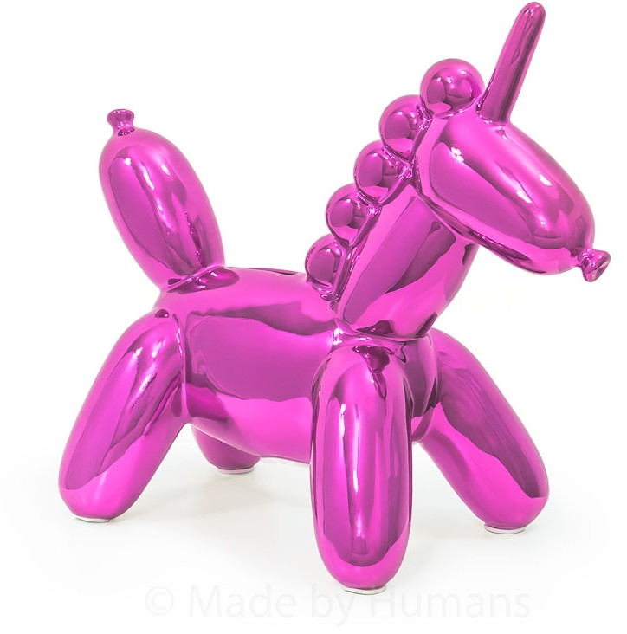
Christmas Gift Ideas
Catalogue 2021
Ballon Money Bank
BIG UNICORN - PINK
Piggy bank, easy access to funds The rubber stopper at the bottom holds your coins securely as you need them, so there is no need to break or crush it.
Color: Pink
Coatings: hi-gloss, electroplated or PVD rainbow
Material: Ceramic
Item size: 11” L x 5.25” W x 10” H
Reg Price : $48.95
NOW: $26.95
Cantidad disponible: 2

Slide 5
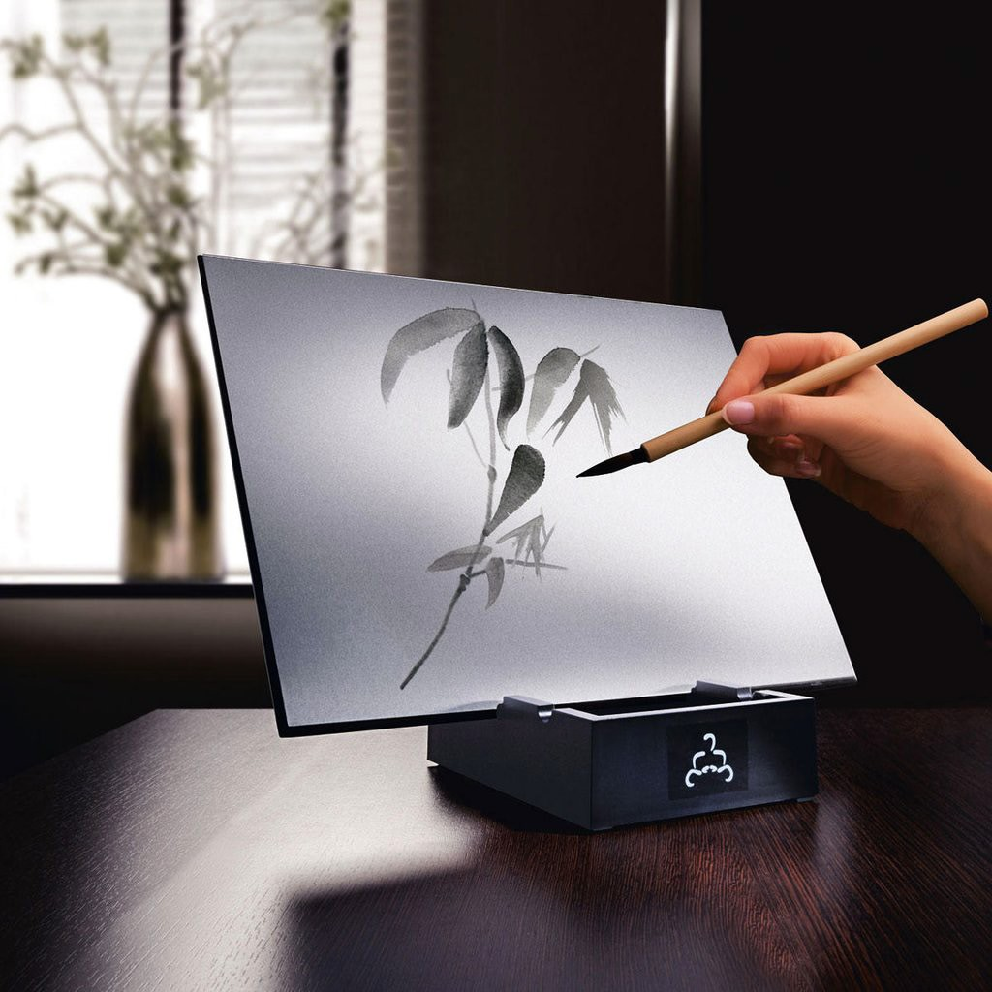
Christmas Gift Ideas
Catalogue 2021
BUDDHA BOARD
original
Buddha Board is inspired by the Zen idea of living in the moment.
Then, as the water slowly evaporates, your art will ma gically disappear leaving you with a clean slate and a clear mind, ready to create a whole new masterpiece.
Dimensions: 12"x9.5"x1/4"
Reg Price : $36.95
NOW: $21.95
Cantidad disponible: 1

Slide 6
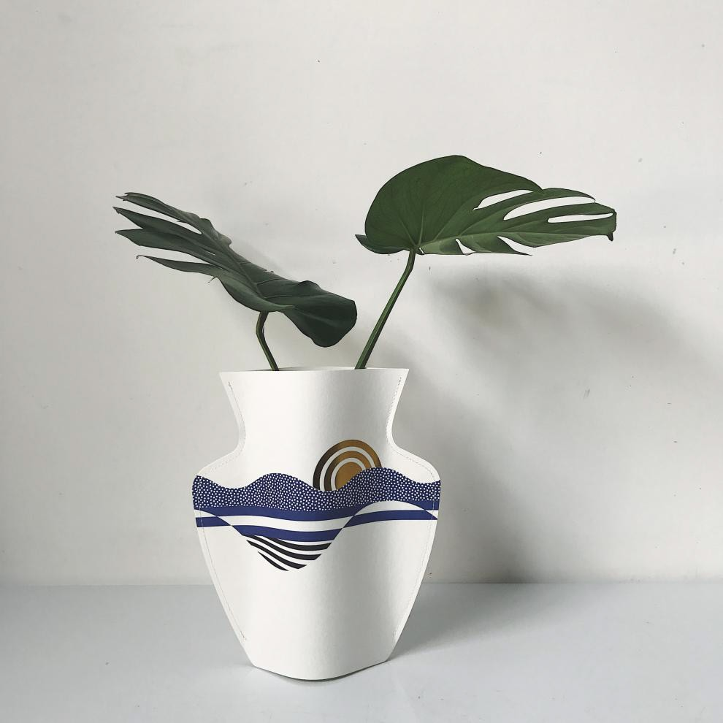
Christmas Gift Ideas
Catalogue 2021
MINI PAPER VASE - SALINA
OCTAEVO
Made of special waterproof paper, it's a tribute to the ancient and sophisticated art of ceramics.
PRODUCT SPECIFICATIONS
Material: Paper Depth (cm): 26,5 cm Height (cm): 29 cm Waterproof: Yes
Reg Price : $14.95
NOW: $8.95
Cantidad disponible: 3

Slide 7
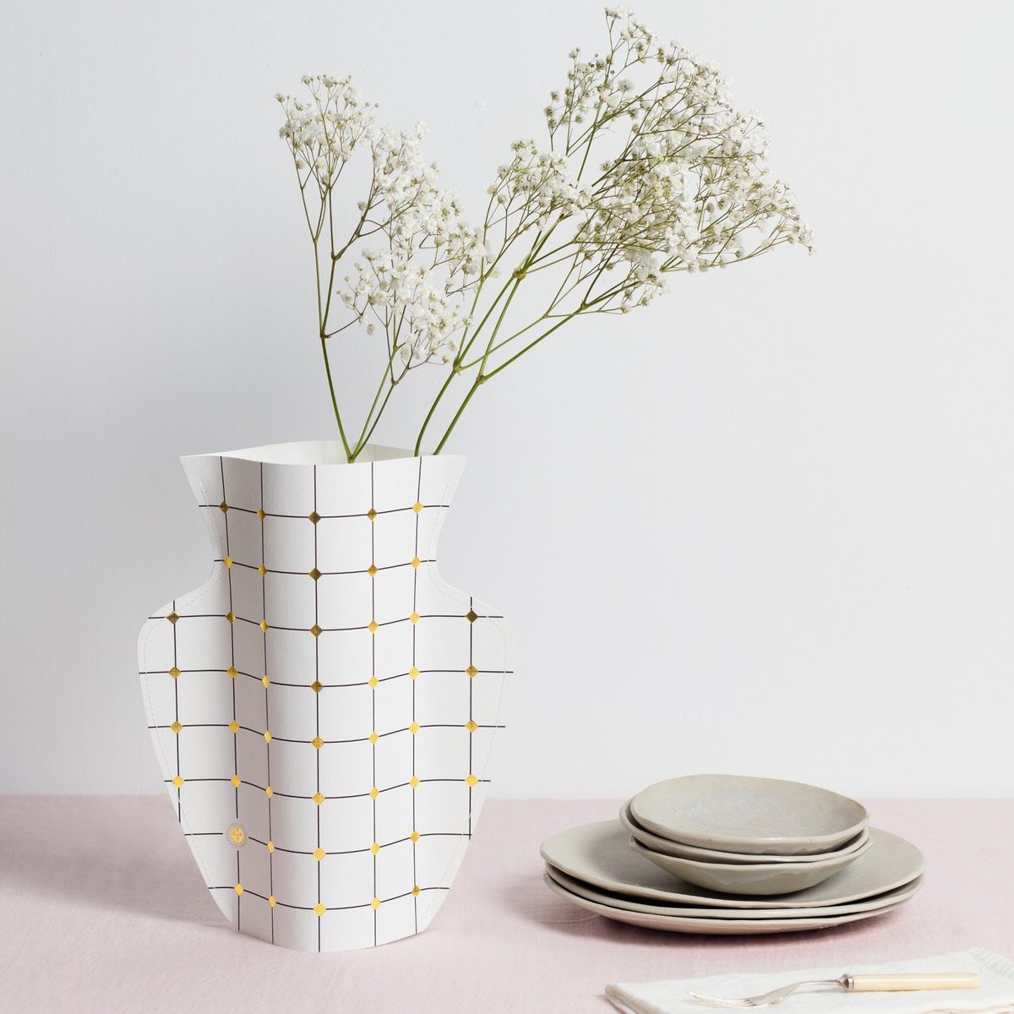
Christmas Gift Ideas
Catalogue 2021
DUNA PAPER VASE
OCTAEVO
Made of special waterproof paper, it's a tribute to the ancient and sophisticated art of ceramics.
PRODUCT SPECIFICATIONS
Material: Paper Depth (cm): 26,5 cm Height (cm): 29 cm Waterproof: Yes
Reg Price : $22.95
NOW: $12.95
Cantidad disponible: 2

Slide 8
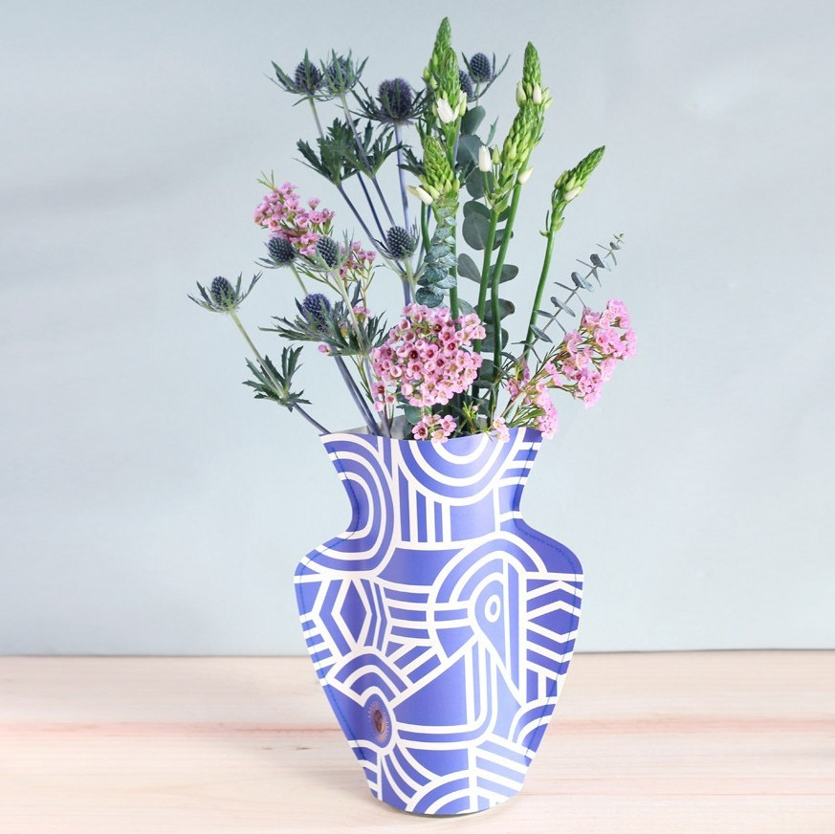
Christmas Gift Ideas
Catalogue 2021
GRECO PAPER VASE
OCTAEVO
Made of special waterproof paper, it's a tribute to the ancient and sophisticated art of ceramics.
PRODUCT SPECIFICATIONS
Material: Paper Depth (cm): 26,5 cm Height (cm): 29 cm Waterproof: Yes
Reg Price : $22.95
NOW: $12.95
Cantidad disponible: 3

Slide 9
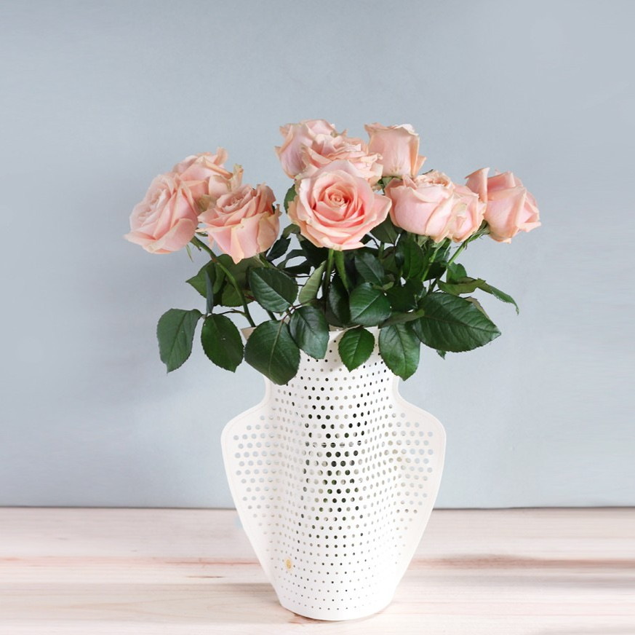
Christmas Gift Ideas
Catalogue 2021
CYANO PAPER VASE
OCTAEVO
Made of special waterproof paper, it's a tribute to the ancient and sophisticated art of ceramics.
PRODUCT SPECIFICATIONS
Material: Paper Depth (cm): 26,5 cm Height (cm): 29 cm Waterproof: Yes
Reg Price : $27.95
NOW: $14.95
Cantidad disponible: 3

Slide 10
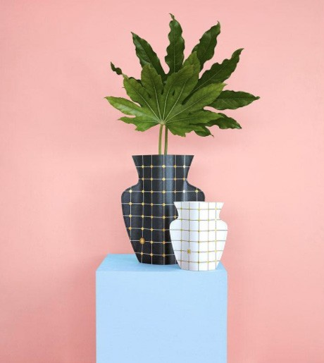
Christmas Gift Ideas
Catalogue 2021
LIDO BLACK PAPER VASE
OCTAEVO
Made of special waterproof paper, it's a tribute to the ancient and sophisticated art of ceramics.
PRODUCT SPECIFICATIONS
Material: Paper Depth (cm): 26,5 cm Height (cm): 29 cm Waterproof: Yes
Reg Price : $22.95
NOW: $12.95
Cantidad disponible: 3

Slide 11
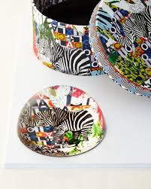
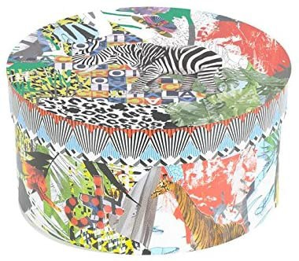
Christmas Gift Ideas
Catalogue 2021
CHRISTIAN LACROIX GLAM'AZONIA
PAPERWEIGHT
The paperweight features a jungle animal design.
Glass and paper material with printed illustration.
Measures 3.5 by 3.5 by 2 inches round.
Reg Price : $48.95
NOW: $24.95
Cantidad disponible: 1

Slide 12
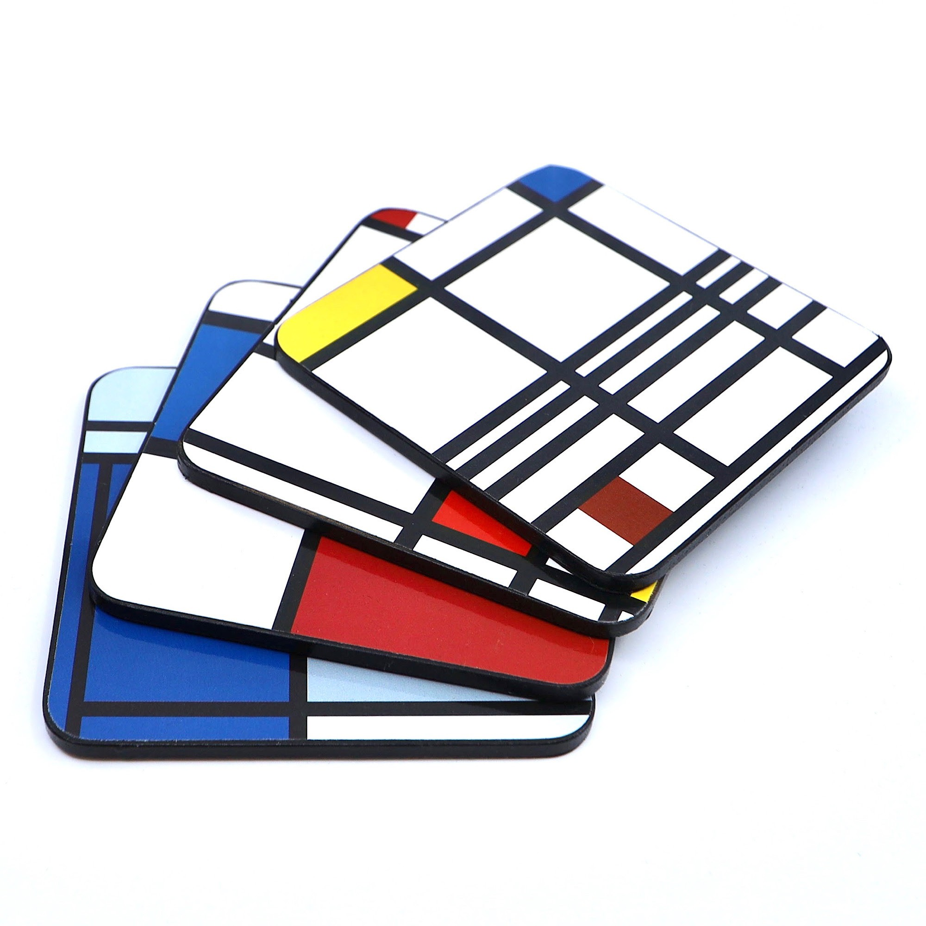
Christmas Gift Ideas
Catalogue 2021
moma MONDRIAN
coasters
Set of four cup holders inspired by the works of Piet Mondrian.
Measures 3.75 "square.
Reg Price : $22.95
NOW: $12.95
Cantidad disponible: 1

Slide 13
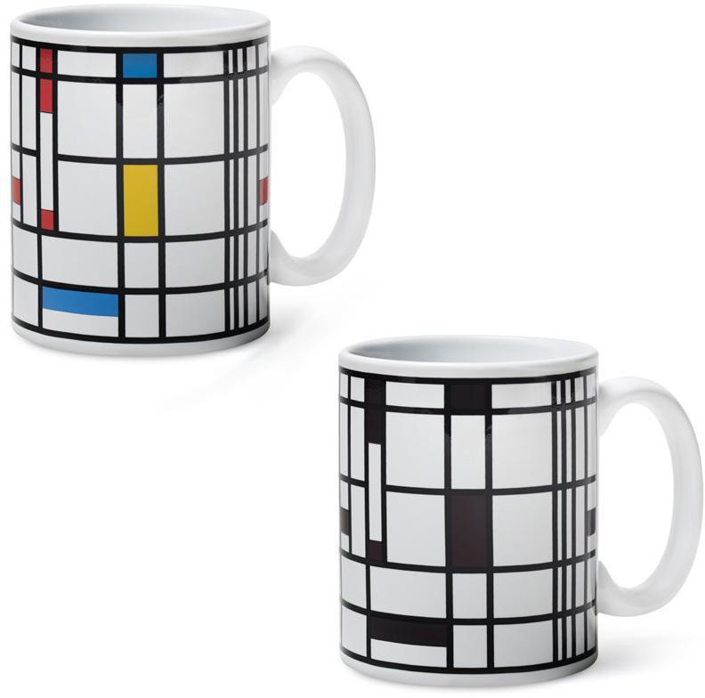
Christmas Gift Ideas
Catalogue 2021
MoMA Mondrian Color
Changing Mug
Every coffee or tea break feels like a trip to MoMA.
Material: Ceramic.
Measures 3.5 "high x 3.25" deep.
Reg Price : $26.95
NOW: $15.95
Cantidad disponible: 2

Slide 14
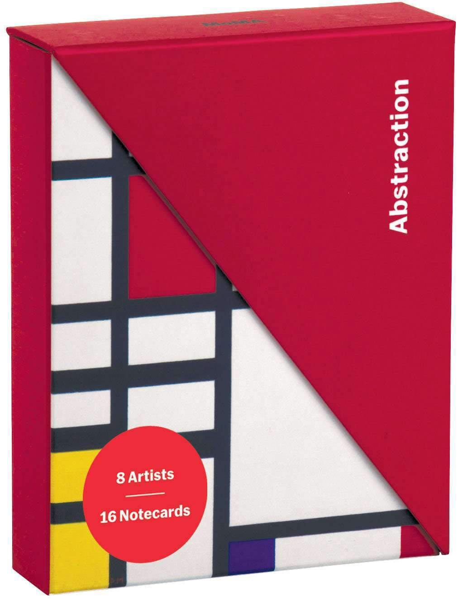
Christmas Gift Ideas
Catalogue 2021
MoMA ABSTRACTION NOTECARD
folio box
Abstraction Notecard Folio Box from Gali- son includes 8 iconic works of art from Museum of Modern Art collection, includ- ing Mark Rothko, Henri Matisse, Georgia O'Keeffe, Piet Mondrian and more. The in- novative two-piece box with triangular top nests in the folio base to create an artistic desktop accessory.
Size: 6 x 5 x 1.5"
2 piece box with triangle lid
8 artists, 16 notecards, 17 white envelopes.
Reg Price : $34.95
NOW: $16.95
Cantidad disponible: 2

Slide 15
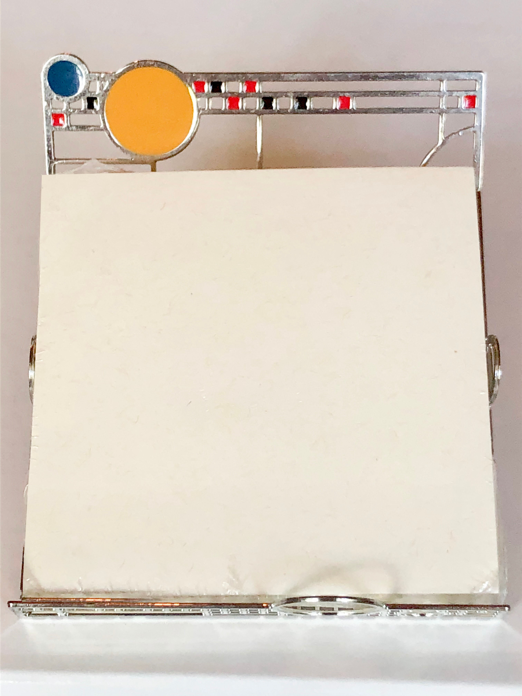
Christmas Gift Ideas
Catalogue 2021
MoMA COONELY NOTE HOLDER
FRANK LLOYD WRIGHT
COONELY NOTE HOLDER / FRANK LLOYD WRIGHT
Reg Price : $36.95
NOW: $17.95
Cantidad disponible: 1

Slide 16
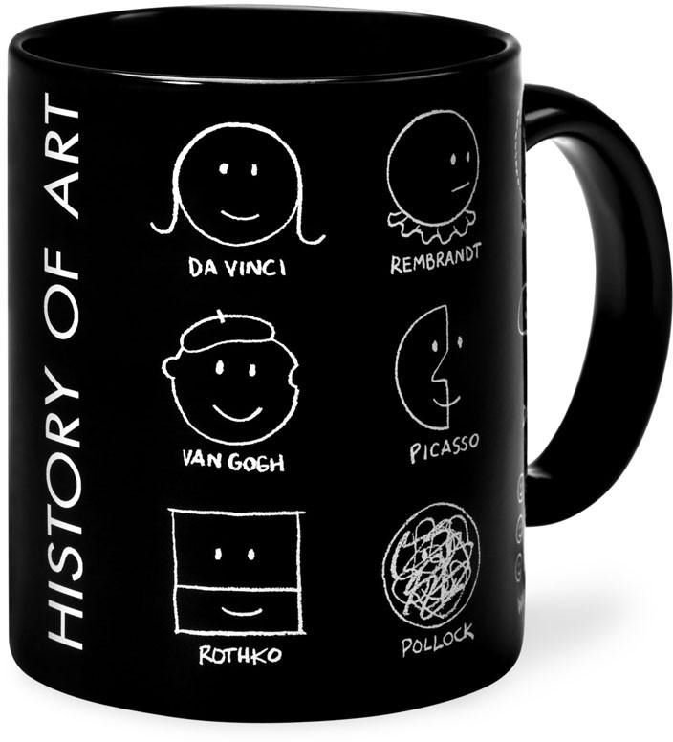
Christmas Gift Ideas
Catalogue 2021
MoMA HISTORY OF ART
mug
This mug describes the history of art with smiley faces modified in the styles of famous artists: Leonardo da Vinci, Rem- brandt, Vincent van Gogh, Mark Rothko, Pablo Picasso and Jackson. Pollock.
Material: Ceramic. Capacity: 10 oz
Reg Price : $16.95
NOW: $9.95
Cantidad disponible: 2

Slide 17
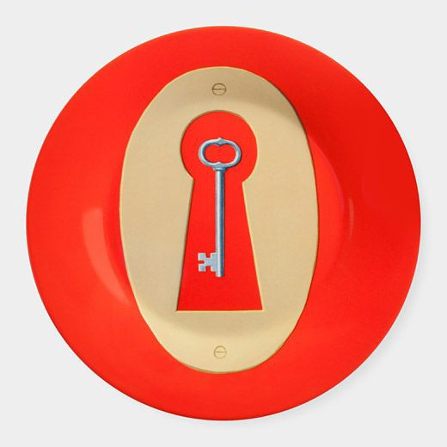
Christmas Gift Ideas
Catalogue 2021
MoMA MAGRITTE LOCK PLATE
Single MoMA Red Key Plate
One of six from the MoMA Magritte Plate Collection
Preserves the vivid color of the painted original on durable, dishwasher-safe melamine
Size 7.75"diam.
Featured in MoMA Exhibition.
Reg Price : $21.95
NOW: $10.95
Cantidad disponible: 4

Slide 18
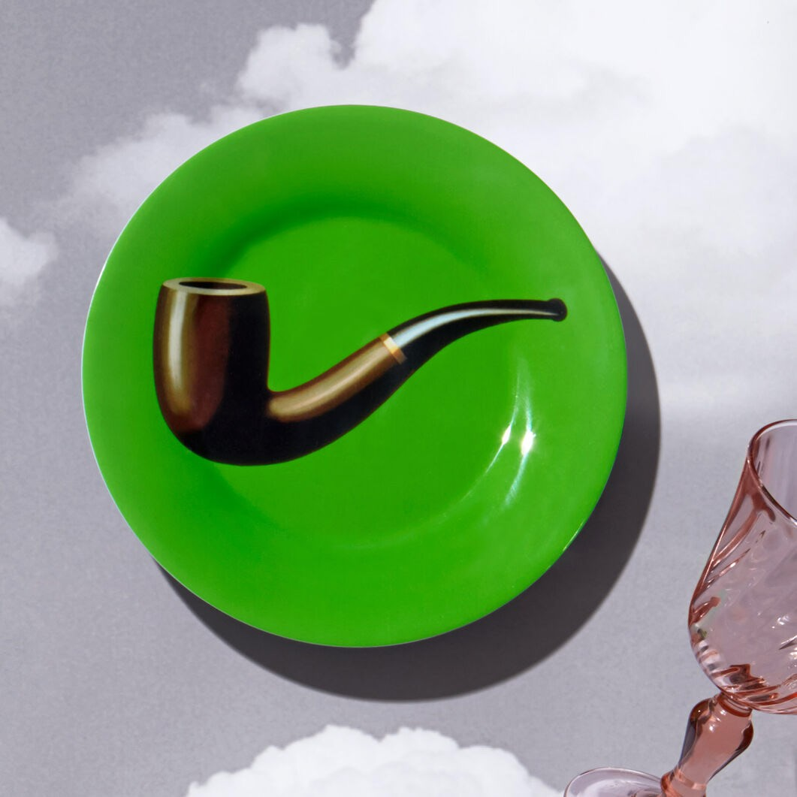
Christmas Gift Ideas
Catalogue 2021
MoMA MAGRITTE PIPE PLATE
Single MoMA Pipe Plate
One of six from the MoMA Magritte Plate Collection
Preserves the vivid color of the painted original on durable, dishwasher-safe melamine
Size 7.75"diam.
Featured in MoMA Exhibition.
Reg Price : $21.95
NOW: $10.95
Cantidad disponible: 2

Slide 19
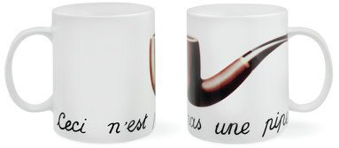
Christmas Gift Ideas
Catalogue 2021
MoMA MAGRITTE PIPE MUG
Iconic image by surrealist artist Rene Mag- ritte
Dishwasher safe
Dimensions: 14.99 x 13.72 x 13.46 cm Weight : 408 g
Material: Ceramic
Reg Price : $22.95
NOW: $12.95
Cantidad disponible: 3

Slide 20
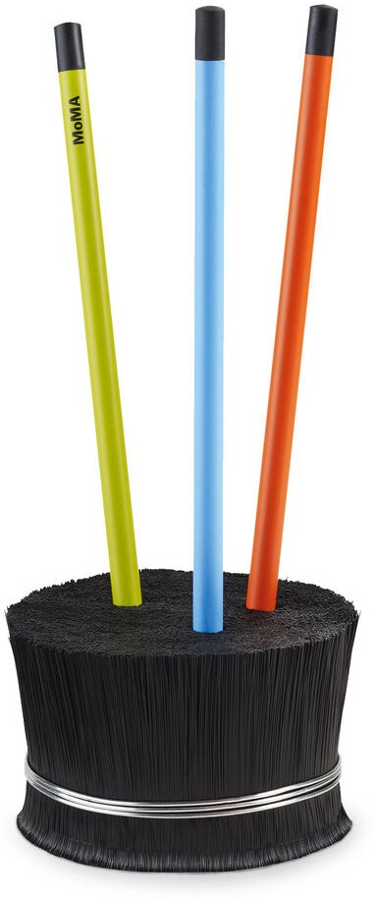
Christmas Gift Ideas
Catalogue 2021
MoMA ERIZO PENCIL HOLDER BLACK
Pencil holder designed by: Mauricio Lara
Size: 2.25h x 3.25"d
Materials: Polypropylene fibers.
Reg Price : $18.95
NOW: $8.95
Cantidad disponible: 11

Slide 21
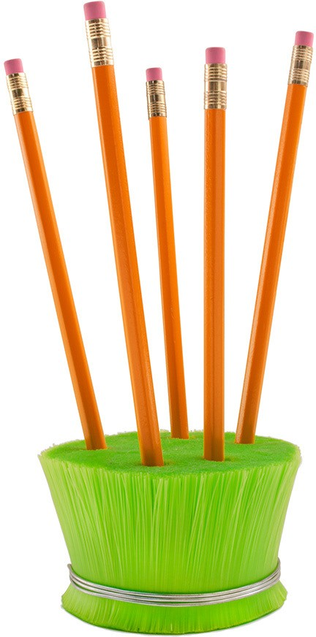
Christmas Gift Ideas
Catalogue 2021
MoMA ERIZO PENCIL
HOLDER green
Pencil holder designed by: Mauricio Lara
Size: 2.25h x 3.25"d
Materials: Polypropylene fibers.
Reg Price : $18.95
NOW: $8.95
Cantidad disponible: 4

Slide 22
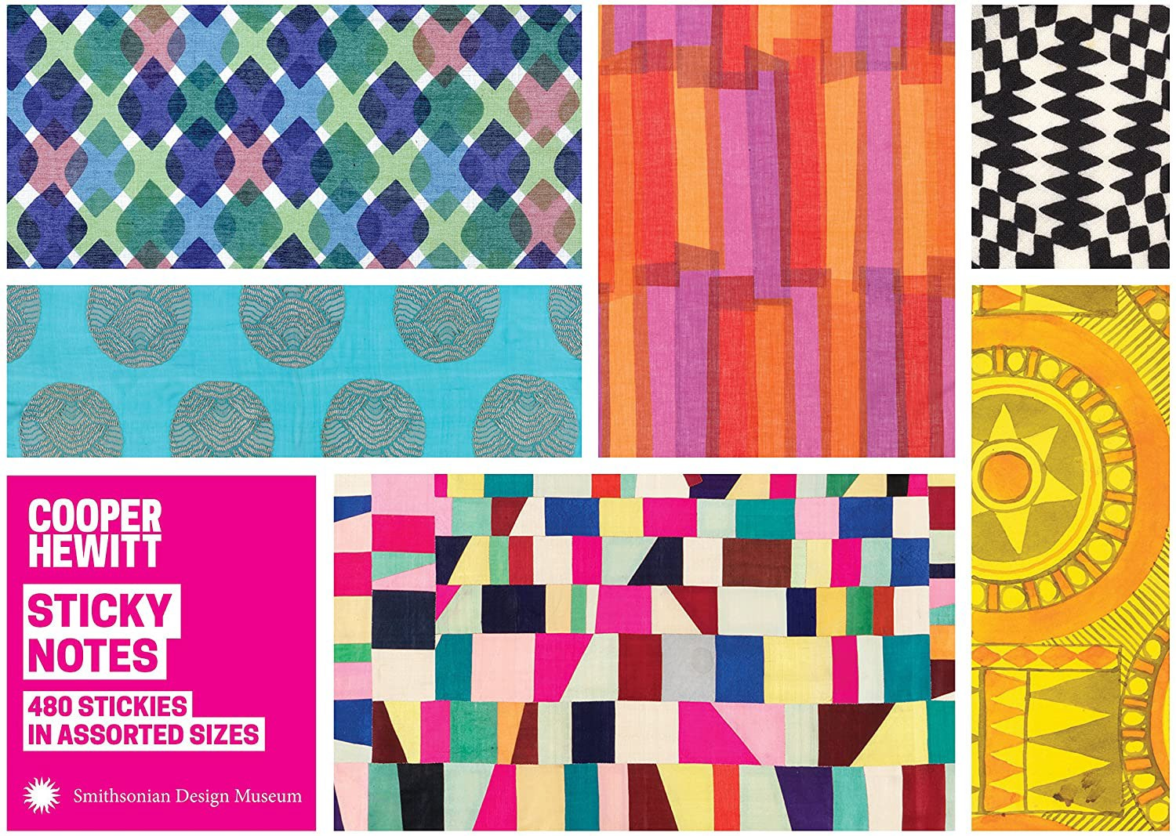
Christmas Gift Ideas
Catalogue 2021
STICKY NOTES
Eclectic and diverse design patterns bring a unique sophistication to this sticky note portfolio.
Perfect for home or office. Quality Materials
Reg Price : $22.95
NOW: $10.95
Cantidad disponible: 2

Slide 23
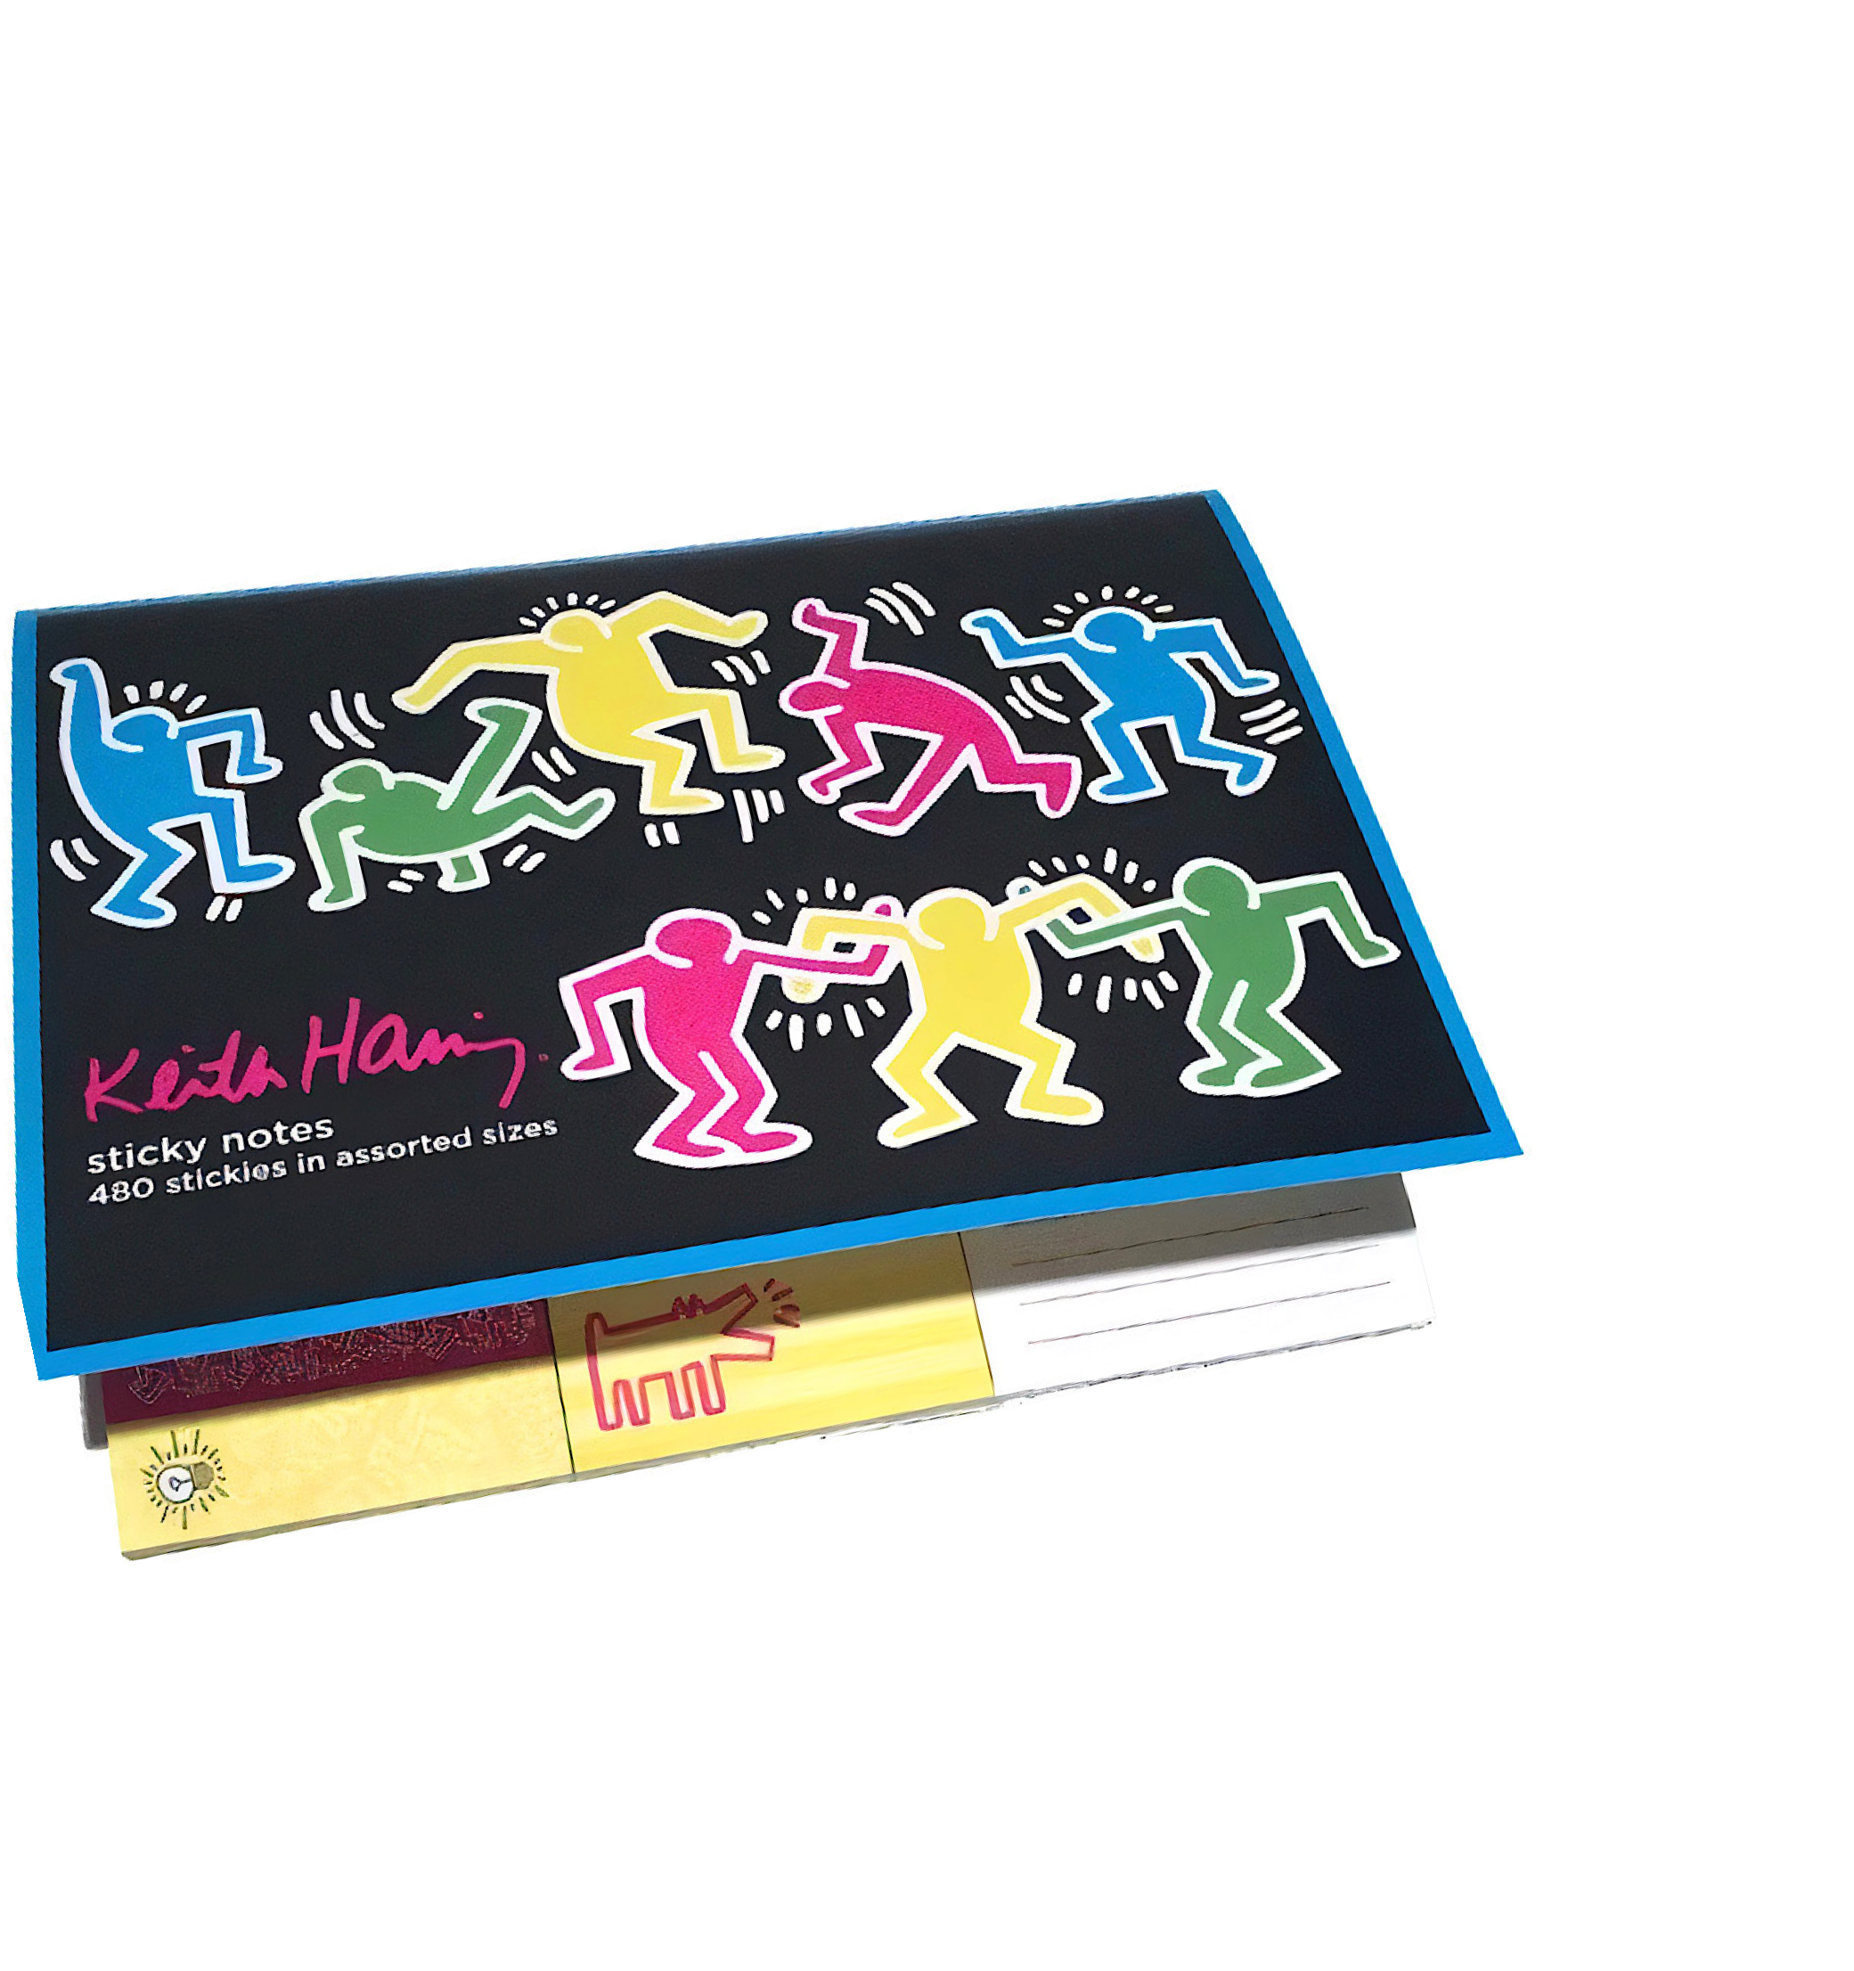
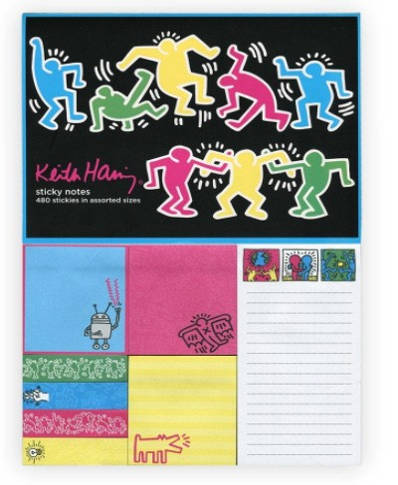
Christmas Gift Ideas
Catalogue 2021
STICKY NOTES
Post a note or leave a reminder with these beautiful sticky notes featuring Keith’s Haring iconic artwork.
Reg Price : $22.95
NOW: $10.95
Cantidad disponible: 3

Slide 24
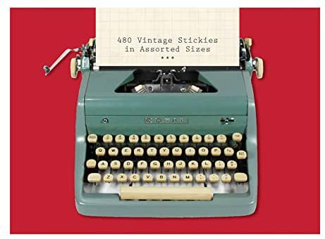
Christmas Gift Ideas
Catalogue 2021
PHAT DOG VINTAGE
STICKY NOTES
Sticky Notes features vintage objects from the archives of Phat Dog Vintage.
The typwriter-adorned portfolio houses eight decorated pads in three different sizes for a total of 480 sticky notes.
Package: 7.25 x 5.38 x 0.38“
8 decorated pads in 3 sizes
Reg Price : $22.95
NOW: $10.95
Cantidad disponible: 2

Slide 25
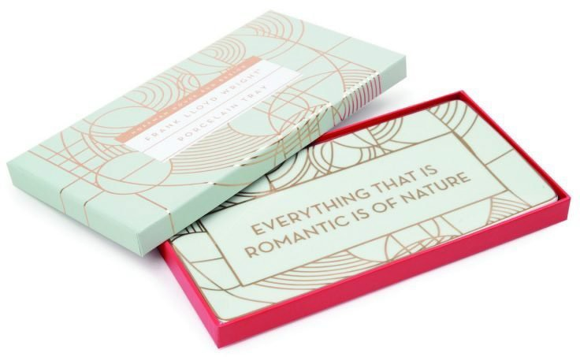
Christmas Gift Ideas
Catalogue 2021
LARGE PORCELAIN TRAY
This beautiful porcelain tray features the designs of Frank Lloyd Wright.
Trimmed with gold this tray is sure to brighten up your desk or any space in your house.
Size: 9.6 x 5.15 x .55''
Reg Price : $48.95
NOW: $26.95
Cantidad disponible: 1

Slide 26
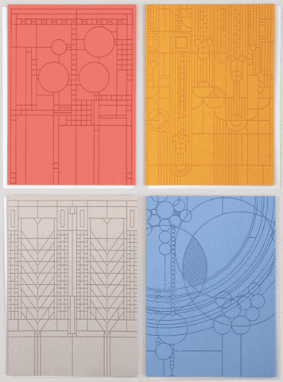
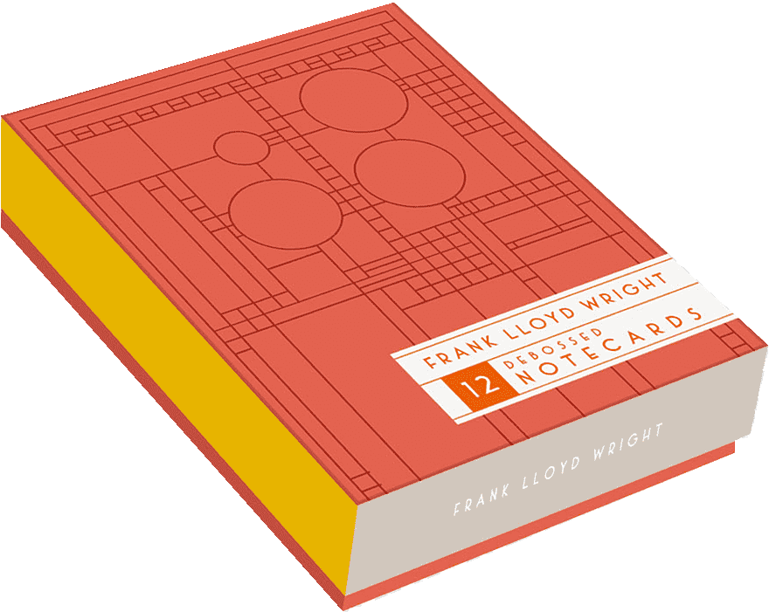
Christmas Gift Ideas
Catalogue 2021
BRIGHT GEOMETRIC DEBOSSED NOTECARDS
Notecards Frank Lloyd Wright's design style. Geometric design. are blank inside to allow for your own personal senti- ment.
Envelopes included. Size: 5x7-inch cards.
Reg Price : $34.95
NOW: $16.95
Cantidad disponible: 1

Slide 27
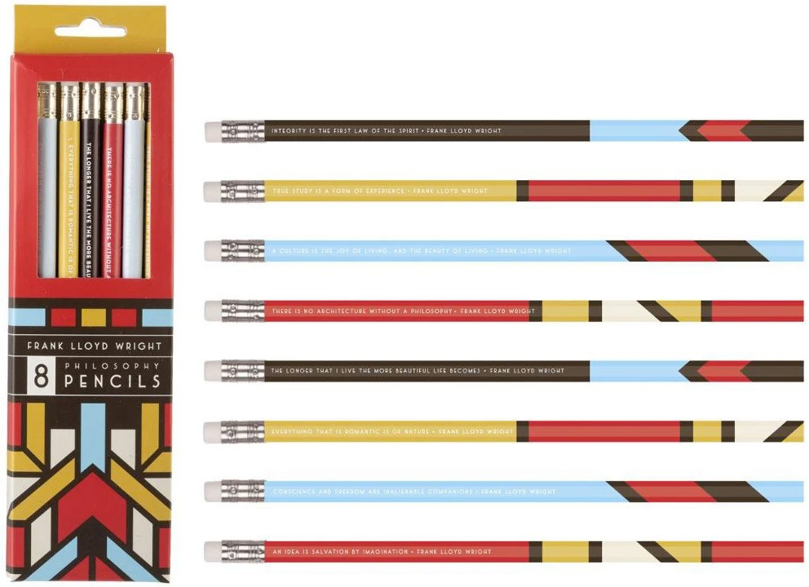
Christmas Gift Ideas
Catalogue 2021
PHILOSOPHY PENCIL
These natural wood standard #2 pencils are each wrapped with color block excerpts of Wright's designs and each also displays a unique quote from Wright.
Set of 8 Quotes Included are: Integrity is the first law of the spirit, True study is a form of experience, A culture is the joy of the Living...and the beauty of living, There is no architecture without a philosophy, The longer I live the more beautiful life becomes, Everything that is romantic is of nature, Conscience and freedom are inalienable companions, An idea is salvation by imagination.
Reg Price : $18.95
NOW: $8.95
Cantidad disponible: 1

Slide 28
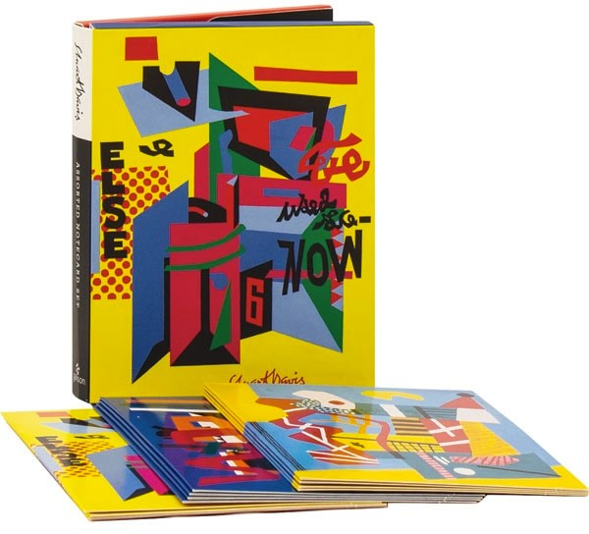
Christmas Gift Ideas
Catalogue 2021
PORTFOLIO NOTECARDS
This set of notecards artwork of modern- ist painter Stuart Davis. Twelve notecards feature three of his most famous works.
12 notecards, 12 envelopes
3 designs
Cards measure: 4.375 x 5.75"
Reg Price : $24.95
NOW: $10.95
Cantidad disponible: 2

Slide 29
Christmas Gift Ideas
Catalogue 2021
PHILOSOPHICAL PENCILS
Exclusive collection of pencils is based on the famous Andy Warhol design.
Contains 8 pencils, erasers in bright shades.
Materials: natural wood.
Reg Price : $18.95
NOW: $8.95
Cantidad disponible: 2

Slide 30
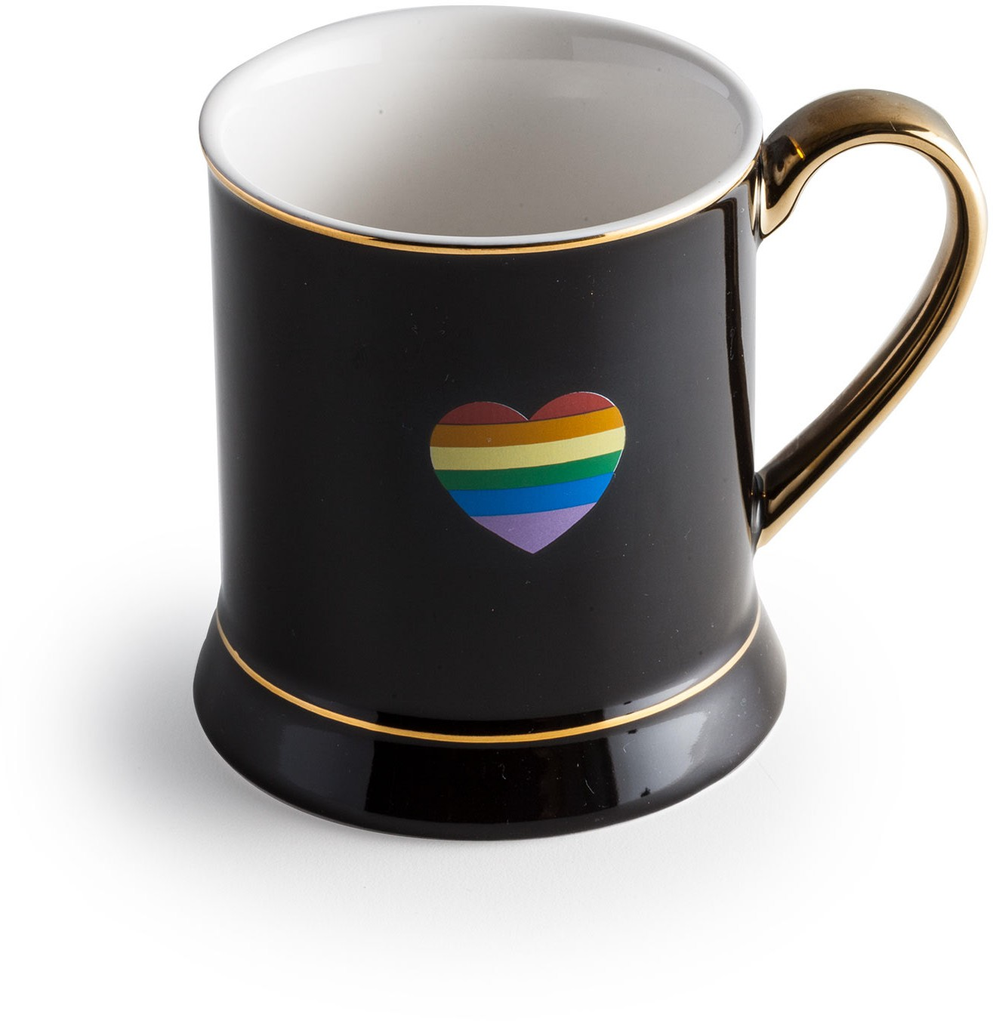
Christmas Gift Ideas
Catalogue 2021
RAINBOW HEART MUG
One mug in a gift box.
Porcelain and gold Capacity is 12 oz.
Reg Price : $22.95
NOW: $11.95
Cantidad disponible: 3

Slide 31
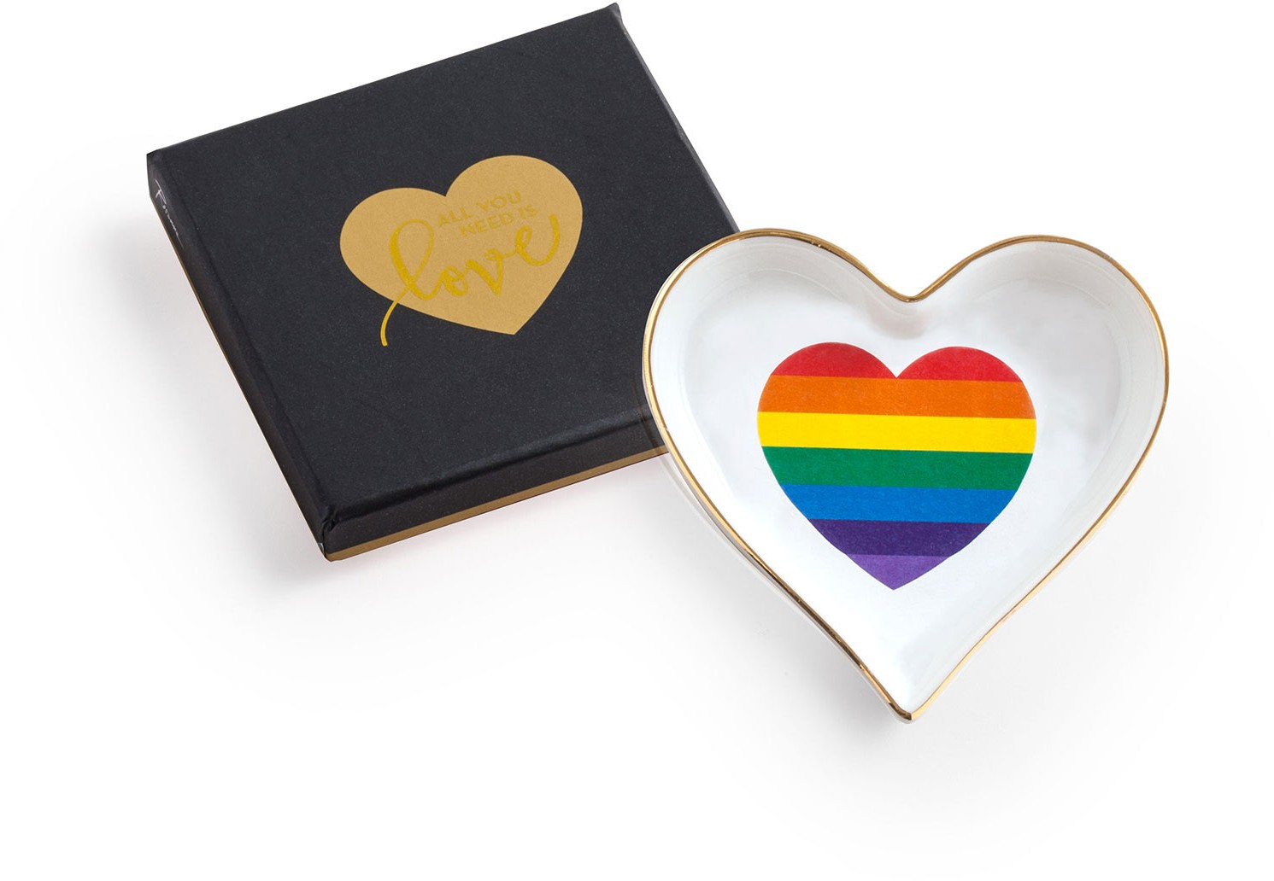
Christmas Gift Ideas
Catalogue 2021
ALL YOU NEED IS LOVE
TRAY HEART
Feel the love, all the time.
One tray in a gift box
Designed in the USA. Manufactured in China.
MATERIAL & CARE: Porcelain and gold
Handwashing recommended. Do not microwave.
DIMENSIONS: 3.5 x 3.5 inches
Reg Price : $15.95
NOW: $8.95
Cantidad disponible: 4

Slide 32
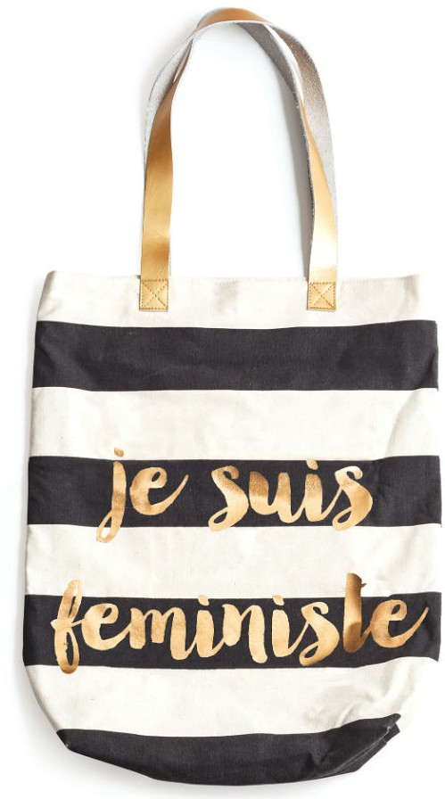
Christmas Gift Ideas
Catalogue 2021
JE SUIS FEMINISTE
tote bag
15 in x 17.5 in
Handwashing recommended. Lay flat to dry.
Canvas and gold foil.
Reg Price : $28.95
NOW: $16.95
Cantidad disponible: 1

Slide 33
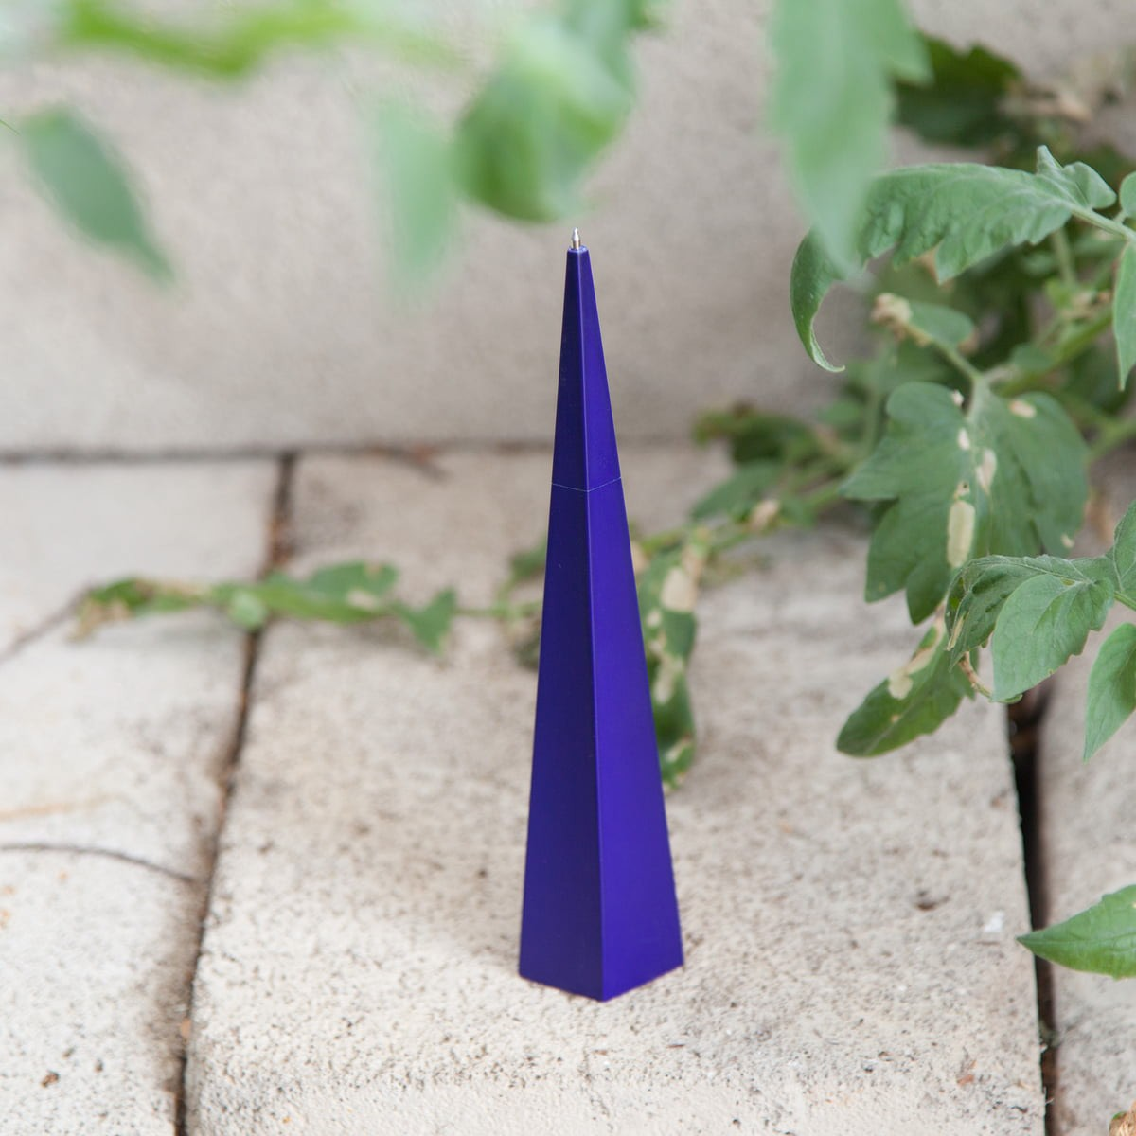
Christmas Gift Ideas
Catalogue 2021
STANDING PEN
BLUE PENTAGON
The standing pen stands on its own.
The upper part of the pen can be unscrewed for ink change.
Reg Price : $15.95
NOW: $9.95
Cantidad disponible: 2

Slide 34
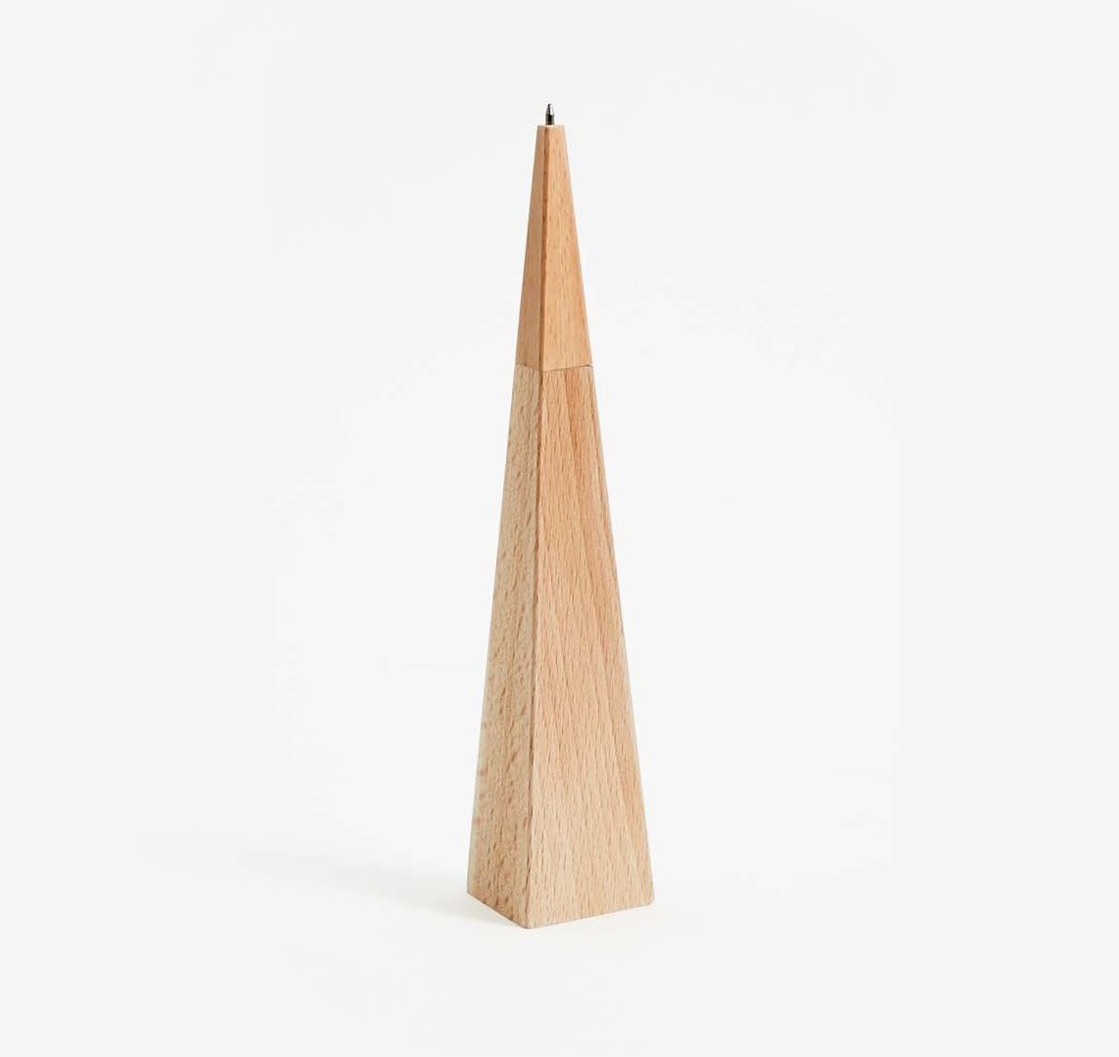
Christmas Gift Ideas
Catalogue 2021
STANDING PEN
natural PENTAGON
The standing pen stands on its own.
The upper part of the pen can be unscrewed for ink change.
Reg Price : $15.95
NOW: $9.95
Cantidad disponible: 5

Slide 35
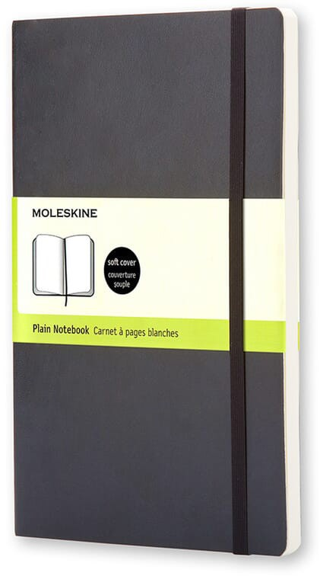
Christmas Gift Ideas
Catalogue 2021
MOLESKINE NOTEBOOK - BLACK
LARGE PLAIN SOFT COVER
Moleskine Soft Notebooks have a soft cover.
The pages bound with thread and on acid-free paper.
Elastic closure and an extendable interior pocket made of cardboard and fabric.
Contains 192 pages
Reg Price : $27.95
NOW: $19.95
Cantidad disponible: 2

Slide 36
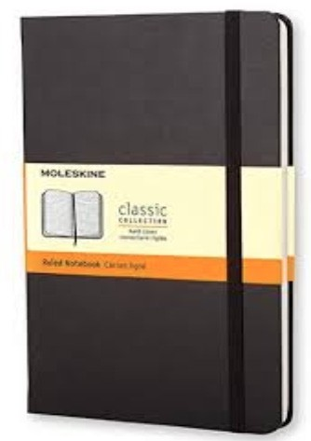
Christmas Gift Ideas
Catalogue 2021
MOLESKINE NOTEBOOK - BLACK
LARGE RULED HARD COVER
Hardcover Cardboard Bound Rounded corners
Acid-free ivory paper Page divider strip Elastic closure
Reg Price : $27.95
NOW: $19.95
Cantidad disponible: 3

Slide 37
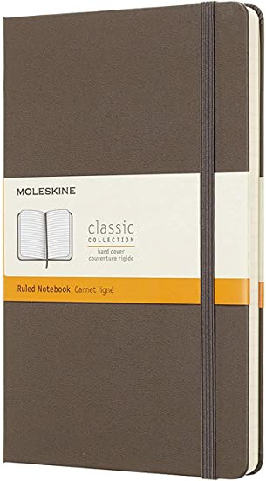
Christmas Gift Ideas
Catalogue 2021
MOLESKINE NOTEBOOK - Brown
LARGE RULED HARD COVER
Moleskine Classic Notebooks is your perfect notebook.
With an elastic closure band and internal storage folders.
Hard cover.
Thick ivory paper pages.
Reg Price : $27.95
NOW: $19.95
Cantidad disponible: 2

Slide 38
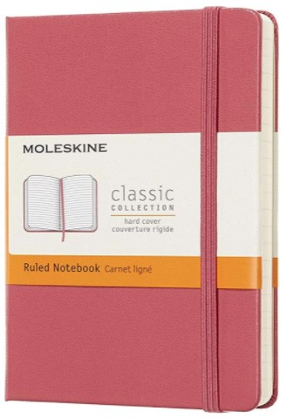
Christmas Gift Ideas
Catalogue 2021
MOLESKINE NOTEBOOK - PINK DAISY FLOWER
LARGE RULED HARD COVER
Moleskine Classic Notebooks is your perfect notebook.
With an elastic closure band and internal storage folders.
Hard cover.
Thick ivory paper pages.
Reg Price : $27.95
NOW: $19.95
Cantidad disponible: 1

Slide 39
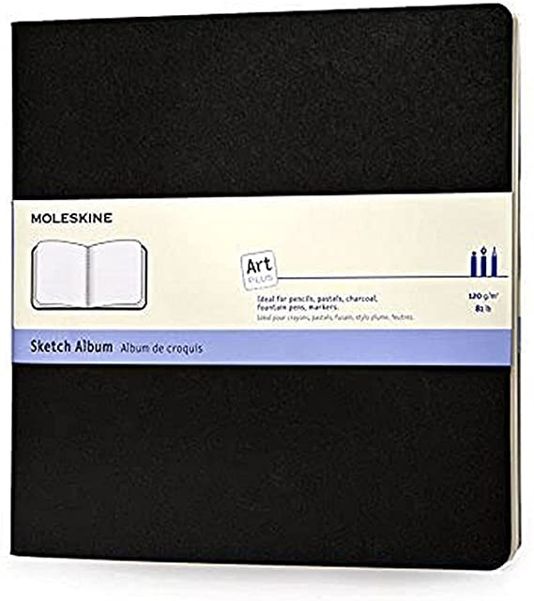
Christmas Gift Ideas
Catalogue 2021
MOLESKINE SKETCHBOOK
SQUARE
Pigmenten sketchbook suitable for using an eraser and is an excellent holder for pens, pencils, charcoal and fountain pens.
88 pages.
Dimensions 19 x 19 cm.
Reg Price : $27.95
NOW: $19.95
Cantidad disponible: 2

Slide 40
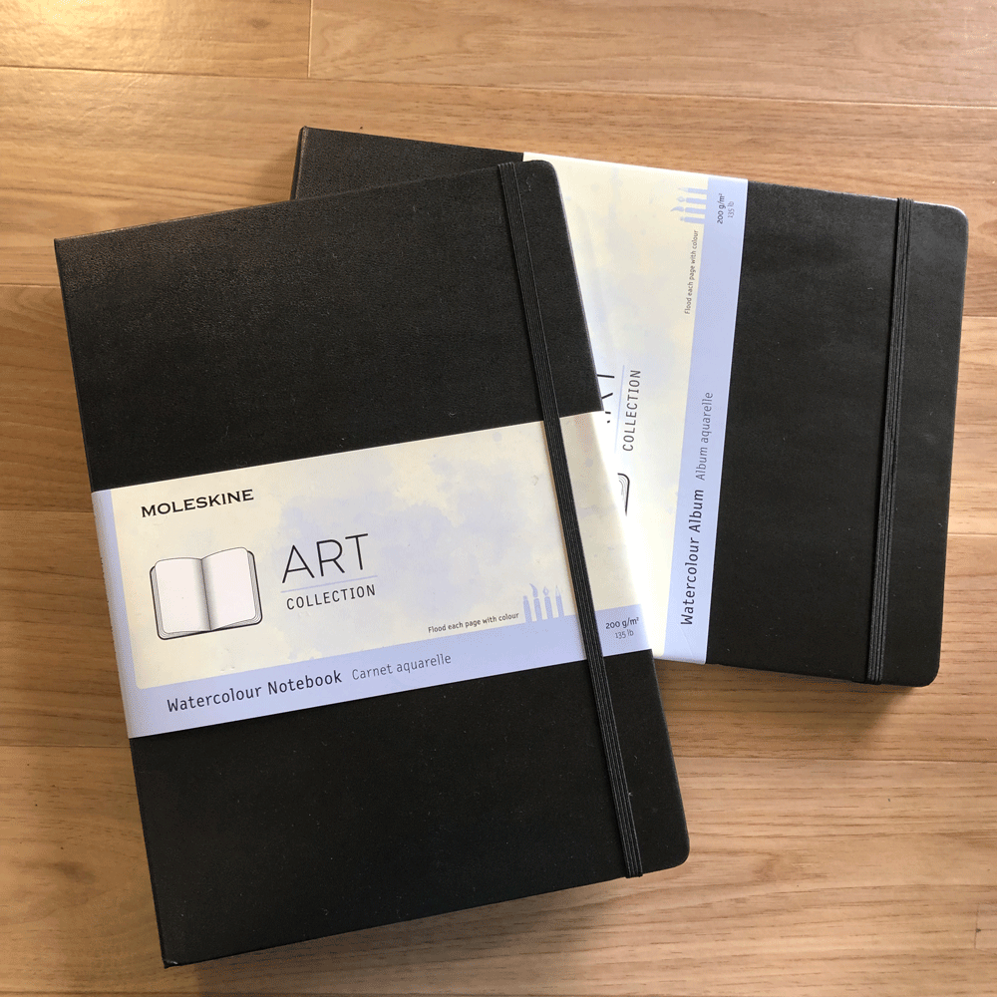
Christmas Gift Ideas
Catalogue 2021
MOLESKINE A4 WATERCOLOR
LARGE RULED HARD COVER
With its elegant black cover, the Moleskine Watercolour Album is your portable art studio.
Made using inviting cold-pressed cotton-blend 200 g/m² paper, it can handle large amounts of water on both sides of the page for luminous and
exciting pictures that express your unique perspective.
Reg Price : $27.95
NOW: $19.95
Cantidad disponible: 2

Slide 41
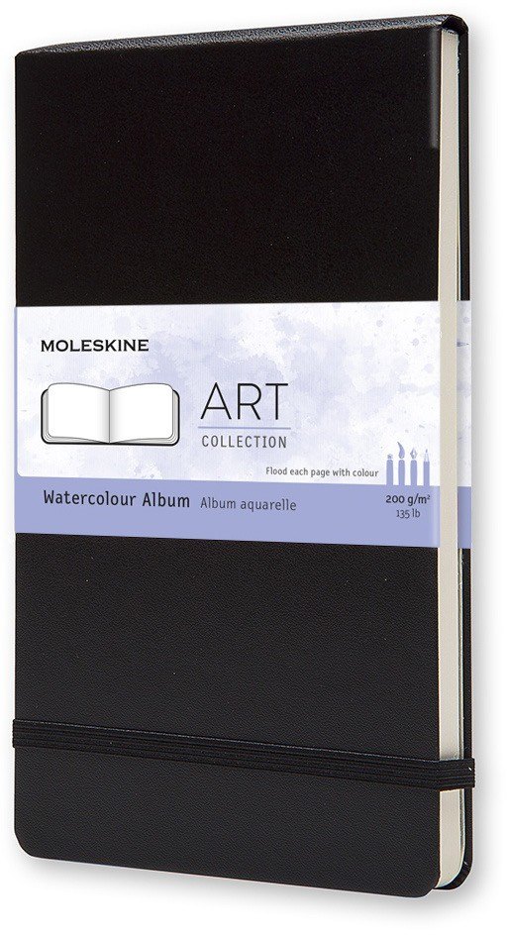
Christmas Gift Ideas
Catalogue 2021
MOLESKINE LARGE WATERCOLOR
LARGE RULED HARD COVER
Sketch pads to heavy paper watercolor .
Thick paper. 72 pages
Reg Price : $27.95
NOW: $19.95
Cantidad disponible: 1

Slide 42
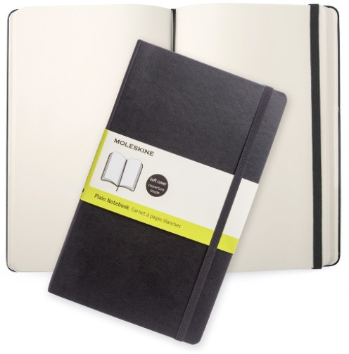
Christmas Gift Ideas
Catalogue 2021
MOLESKINE NOTEBOOK - BLACK
POCKET PLAIN SOFT COVER
Moleskine Plain Soft Cover Notebook
192 pages
Reg Price : 27.95
NOW: $19.95
Cantidad disponible: 2

Slide 43
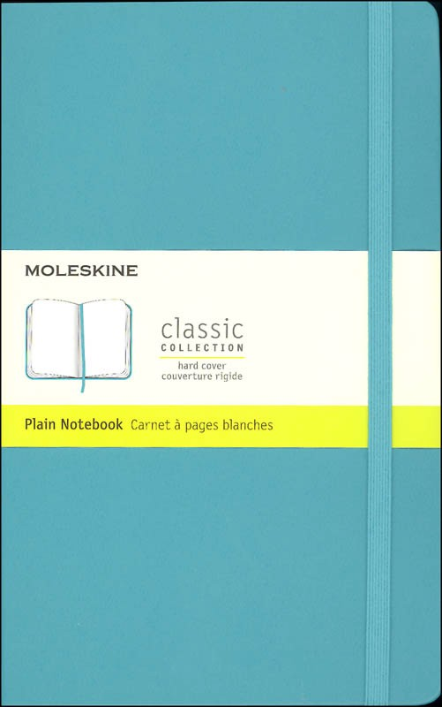
Christmas Gift Ideas
Catalogue 2021
MOLESKINE NOTEBOOK - blue Reef
LARGE pLAIN HARD COVER
Hard cover, rounded corners.
Elastic closure.
Ivory acid free paper.
Reg Price : $27.95
NOW: $19.95
Cantidad disponible: 2

Slide 44
Christmas Gift Ideas
Catalogue 2021
MOLESKINE NOTEBOOK - BLACK
LARGE RULED soft COVER
Softcover Cardboard Bound Rounded corners
Acid-free ivory paper Page divider strip Elastic closure
Reg Price : $27.95
NOW: $19.95
Cantidad disponible: 3

Slide 45
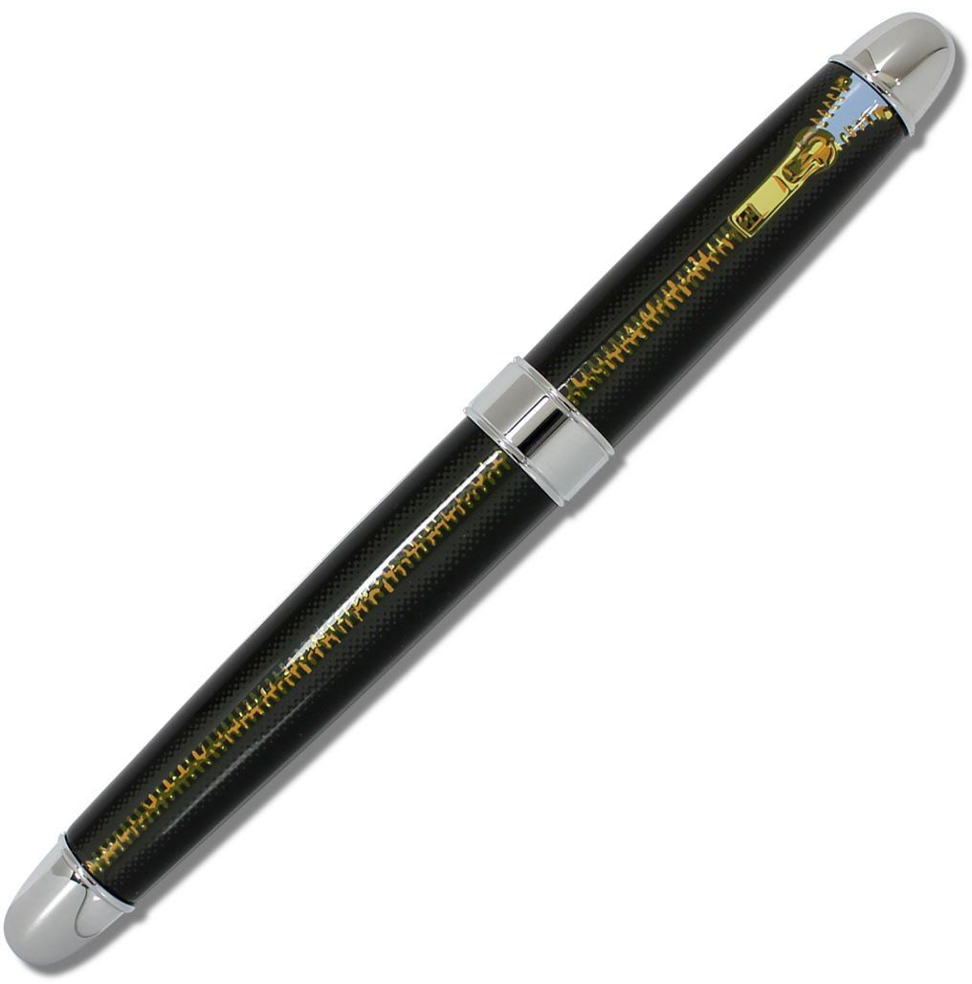
Christmas Gift Ideas
Catalogue 2021
ACME DESIGN ZIPPER
ROLLER BALL PEN
"Zipper” Pen designed by Ron English
Product: Roller Ball
Hand applied lacquer on brass
5.25 x 0.75 in
13.3 x 1.9 cm
Reg Price : $99.95
NOW: $69.95
Cantidad disponible: 1

Slide 46
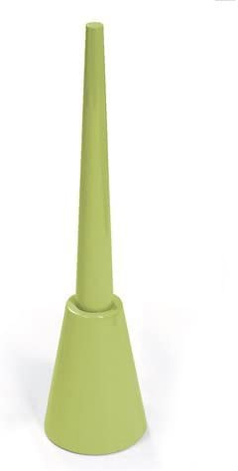
Christmas Gift Ideas
Catalogue 2021
MAGNETIC DESK PEN
green
Colour: Green
Dimensions 8.1 x 4.3 x 15.2 cm
About this item: Weighted magnetic base holds pens securely in place
Black ballpoint Parker style refill.
Felt bottom on base for protection Gift boxed.
Reg Price : $16.95
NOW: $10.95
Cantidad disponible: 1

Slide 47
Christmas Gift Ideas
Catalogue 2021
MAGNETIC DESK PEN
CRIMSON/PINK
Colour: Crimson / Pink
Dimensions 8.1 x 4.3 x 15.2 cm
About this item: Weighted magnetic base holds pens securely in place
Black ballpoint Parker style refill.
Felt bottom on base for protection Gift boxed.
Reg Price : $16.95
NOW: $10.95
Cantidad disponible: 2

Slide 48
Christmas Gift Ideas
Catalogue 2021
MAGNETIC DESK PEN
white
Colour: White
Dimensions 8.1 x 4.3 x 15.2 cm
About this item: Weighted magnetic base holds pens securely in place
Black ballpoint Parker style refill.
Felt bottom on base for protection Gift boxed.
Reg Price : $16.95
NOW: $10.95
Cantidad disponible: 1

Slide 49
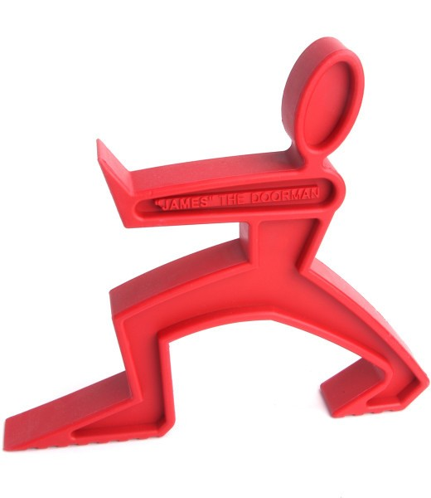
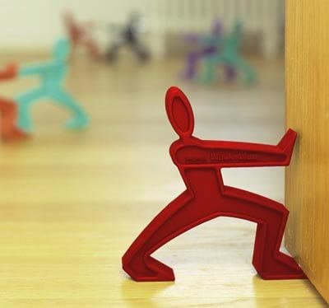
Christmas Gift Ideas
Catalogue 2021
BLACK & BLOOM JAMES
THE DOORMAN - red
The innovative red rubber stopper.
Doorstop, made of synthetic rubber
It is easy to clean.
Reg Price : $22.95
NOW: $12.95
Cantidad disponible: 2

Slide 50
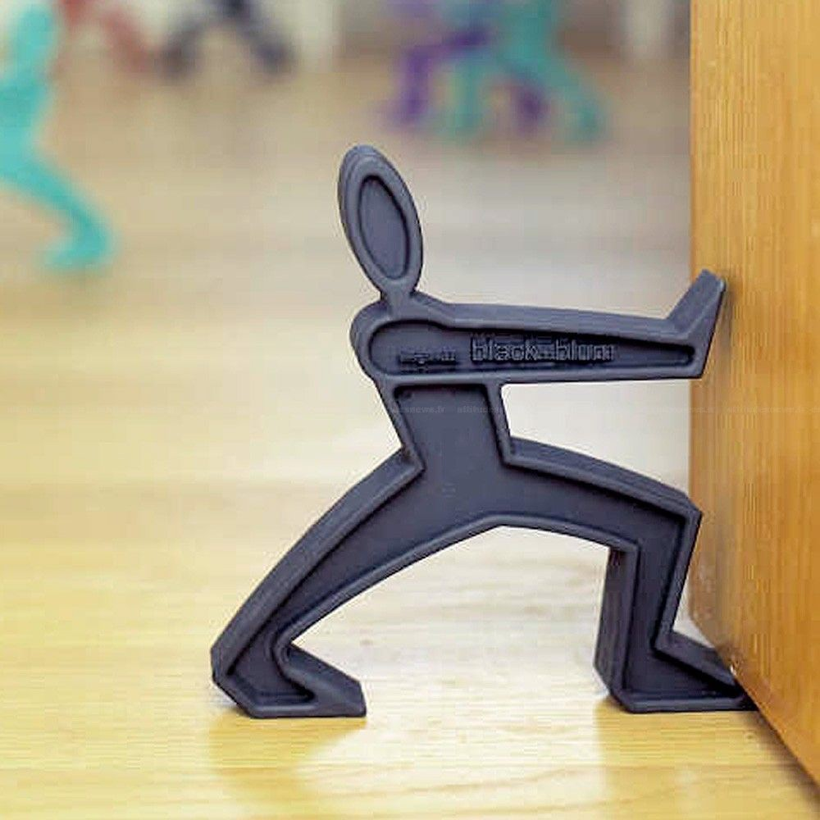
Christmas Gift Ideas
Catalogue 2021
BLACK & BLOOM JAMES
THE DOORMAN - black
The innovative red rubber stopper.
Doorstop, made of synthetic rubber
It is easy to clean.
Reg Price : $22.95
NOW: $12.95
Cantidad disponible: 2

Slide 51
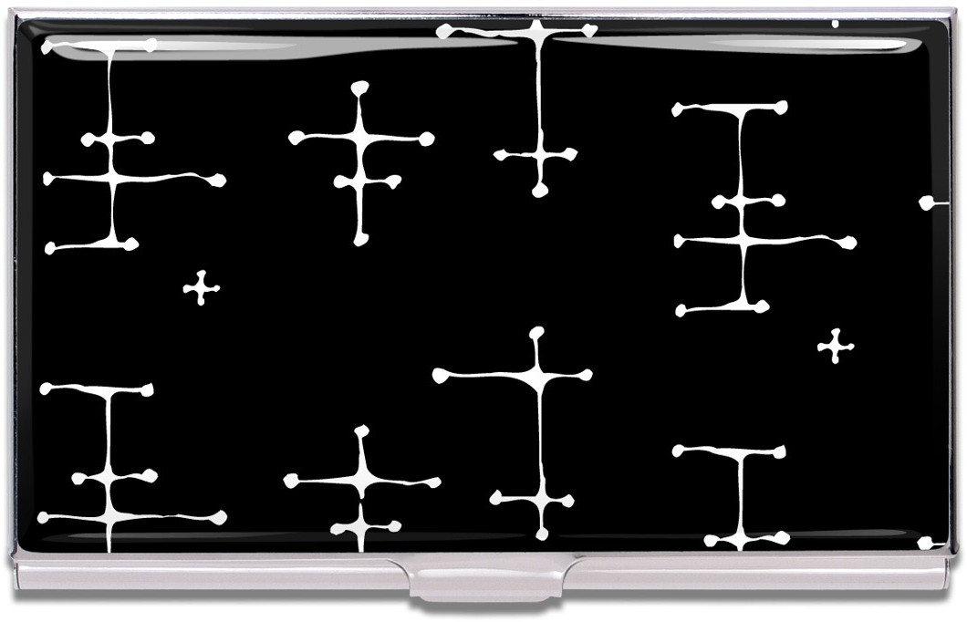
Christmas Gift Ideas
Catalogue 2021
ACME DOTS
BUSINESS CARD CASE
“Dots” Business Card Case, designed by Charles & Ray Eames
Cases have mirror chrome metal finish inside and out with a unique image applied to the lid.
For an artist’s business cards or the cards of an enthusiast with a keen sense of style.
Reg Price : $39.95
NOW: $19.95
Cantidad disponible: 1

Slide 52
Christmas Gift Ideas
Catalogue 2021
ACME BLUEPRINT
BUSINESS CARD CASE
“Blueprints” Business Card Case, designed by Constantin Boym
Cases have mirror chrome metal finish inside and out with a unique image applied to the lid.
For an artist’s business cards or the cards of an enthusiast with a keen sense of style.
Reg Price : $39.95
NOW: $19.95
Cantidad disponible: 1

Slide 53
Christmas Gift Ideas
Catalogue 2021
ACME RHAPSODY
BUSINESS CARD CASE
“Rhapsody” Business Card Case, designed by Alena St. James,
Cases have mirror chrome metal finish inside and out with a unique image applied to the lid.
For an artist’s business cards or the cards of an enthusiast with a keen sense of style.
Reg Price : $39.95
NOW: $19.95
Cantidad disponible: 1

Slide 54
Christmas Gift Ideas
Catalogue 2021
ACME CLOCKS
BUSINESS CARD CASE
“Clocks” Business Card Case, Designed by Nancy Wolff
Cases have mirror chrome metal finish inside and out with a unique image applied to the lid.
For an artist’s business cards or the cards of an enthusiast with a keen sense of style.
Reg Price : $39.95
NOW: $19.95
Cantidad disponible: 1

Slide 55
Christmas Gift Ideas
Catalogue 2021
ACME KRAZE
BUSINESS CARD CASE
Kraze” Business Card Case, designed by Karim Rashid.
Cases have mirror chrome metal finish inside and out with a unique image applied to the lid.
For an artist’s business cards or the cards of an enthusiast with a keen sense of style.
Reg Price : $39.95
NOW: $19.95
Cantidad disponible: 1

Slide 56
Christmas Gift Ideas
Catalogue 2021
BONE CHINA MUG
GUERRILLA GIRLS
New Bone China
Dishwasher safe Open edition
3.9” x 3.1” diameter (9.8cm x 8.3cm)
Reg Price : $22.95
NOW: $11.95
Cantidad disponible: 2

Slide 57
Christmas Gift Ideas
Catalogue 2021
THE ADVANTAGES OF BEING A WOMAN ARTIST CLUTCH
GUERRILLA GIRLS
A bag for anything you want.
Material 100% cotton.
Size 28cm x 20cm (11 "x 7.8").
Reg Price : $26.95
NOW: $14.95
Cantidad disponible: 1

Slide 58
Christmas Gift Ideas
Catalogue 2021
DEAR ART COLLECTOR HANDKERCHIEF
GUERRILLA GIRLS
It can be seen as a functional household art handkerchief or a piece of art for framing and display.
Digital print, 100% Cotton and embroidery.
Reg Price : $15.95
NOW: $9.95
Cantidad disponible: 4

Slide 59
Christmas Gift Ideas
Catalogue 2021
IF ALPHABOOKS -LOVE
Alphabooks are the perfect gift for book lovers.
Writing diaries with a different twist or just as a conversation piece on your shelves.
Its decorated cover, a spine adorned with gold and cream colored paper inside.
Design and colors may vary.
Reg Price : $48.95
NOW: $24.95
Cantidad disponible: 2

Slide 60
Christmas Gift Ideas
Catalogue 2021
IF ALPHABOOKS - art
Alphabooks are the perfect gift for book lovers.
Writing diaries with a different twist or just as a conversation piece on your shelves.
Its decorated cover, a spine adorned with gold and cream colored paper inside.
Designs and colors may vary.
Reg Price : $34.95
NOW: $15.95
Cantidad disponible: 1

Slide 61
Christmas Gift Ideas
Catalogue 2021
ECCOLO LIGHT BLUE
GIANT ERASER
Draft ready for any mistakes.
Measures 1 x 5.75 x 2 inches
Reg Price : $9.95
NOW: $5.95
Cantidad disponible: 1
O C T A E V

Slide 62
Christmas Gift Ideas
Catalogue 2021
ECCOLO TURQUOISE
GIANT ERASER
A giant oversized eraser, where mistakes won't stand a chance!
Measures 25 x 146 x 51 millimeters.
Reg Price : $9.95
NOW: $5.95
Cantidad disponible: 2

Slide 63
Christmas Gift Ideas
Catalogue 2021
WORDS CUBE
8 wood word blocks with graphically-unique words
silk-screened onto each of the cubes six sides
48 creative words Displayed in a wood tray
Cube size: 1 3/8" x 1 3/8" x 1 3/8" Tray size: 11.25" L x 2.25" H
Reg Price : $18.95
NOW: $9.95
Cantidad disponible: 4

Slide 64
Christmas Gift Ideas
Catalogue 2021
REMOTE CONTROl NOTEBOOK
BLACK SERIES
Dream comes true! Remote control can maintain your heart in childhood and everything is possible. Holding it on your hands, nothing can beat you! You are a great magician, and everything will do whatever you want. Imagination can keep springing from your brain when grasping the remote control. Designer keeps the blank pages for your magical world with unlimited imagination. It is the best partner of your free sketch or illustration.
Size：190mm X 120mm X 60mm weight；300g Material PVC/Paper made in Taiwan
Reg Price : $14.95
NOW: $8.95
Cantidad disponible: 2

Slide 65
Christmas Gift Ideas
Catalogue 2021
john sees the painting mug
Materials: fine bone china
Care instructions: dishwasher and microwave safe
Size: 9.8cm x 8.3cm diameter (3.9" x 3.1")
Reg Price : $39.95
NOW: $22.95
Cantidad disponible: 1

Slide 66
Christmas Gift Ideas
Catalogue 2021
BE THE PERSON YOUR DOG THINKS YOU ARE
SQUARE TRAY
Desk Tray with Wise Sayings.
Material: Porcelain
Dimensions: 6 1/2 "W x 5 3/4" D x 1 "H
Reg Price : $21.95
NOW: $10.95
Cantidad disponible: 1

Slide 67
Christmas Gift Ideas
Catalogue 2021
FINCH MOD SMALL BIRD
DECOR SCULPTURE
Color White
Material Ceramic
Item Dimensions: L x W x H 11 x
3.25 x 6.5 inches
Reg Price : $29.95
NOW: $14.95
Cantidad disponible: 1

Slide 68
Christmas Gift Ideas
Catalogue 2021
DEBOSSED DOTTED
SITTING BIRD WHITE
White resin figure and sculpture for home
White in color. Resin material.
Measures 7 x 4 x 5.5 inches.
Reg Price : $21.95
NOW: $12.95
Cantidad disponible: 1

Slide 69
Christmas Gift Ideas
Catalogue 2021
CORAL TREE
JEWELRY HOLDER
Constructed of Resin To Create The Look Of Coral
White In Color
Beautiful to use As Jewelry Holder
Reg Price : $34.95
NOW: $16.95
Cantidad disponible: 1

Slide 70
Christmas Gift Ideas
Catalogue 2021
PAIR OF CONTEMPORARY STATUES
COLOR / FINISH black, white limestone
MATERIAL Iron, Limestone
Dimensions: 3"L x 3"W x 21"H (11.05 lbs)
Reg Price : $295.00
NOW: $149.95
Cantidad disponible: 2

Slide 71
Christmas Gift Ideas
Catalogue 2021
EQUESTRIAN WROUGHT IRON HURRICANE
It is a perfect centerpiece for a desired table or space.
Handcrafted.
Material glass and metal plate.
Reg Price : $112.00
NOW: $56.95
Cantidad disponible: 2

Slide 72
Christmas Gift Ideas
Catalogue 2021
CHARISMA WROUGHT IRON HURRICANE
Geometric details give the simple and elegant look.
Bronze iron material.
Reg Price : $48.95
NOW: $26.95
Cantidad disponible: 3

Slide 73
Christmas Gift Ideas
Catalogue 2021
LILO DIMPLED CERAMIC
VASE short
Gold colored vase.
Measures 4.25 X 3 X 8.75" Ceramic material.
Reg Price : $23.95
NOW: $12.95
Cantidad disponible: 1

Slide 74
Christmas Gift Ideas
Catalogue 2021
CEDRE - SCENTED CERAMIC DECORATIVE SET
Geometric details give the simple and elegant look.
Bronze iron material.
Reg Price : $42.95
NOW: $22.95
Cantidad disponible: 3

Slide 75
Christmas Gift Ideas
Catalogue 2021
PLAY WITH THE BALLOON TOTE
WE GO TO THE GALLERY
The perfect bag for your next outing and even more practical with an inside pocket for your phone.
Measures 39cm x 68cm (15.3 "x 26.7").
Reg Price : $32.95
NOW: $16.95
Cantidad disponible: 1

Slide 76
Christmas Gift Ideas
Catalogue 2021
MODERN ART MUG
CRAIG DAMRAUER
New Bone China
Dishwasher safe Size: 8.5cm x 9.8cm
14oz (440ml) capacity
Reg Price : $22.95
NOW: $11.95
Cantidad disponible: 2

Slide 77
books

Slide 78
Christmas Gift Ideas
Catalogue 2021
ALMOST EVERYTHING
NOTES ON HOPE BY ANNE LAMOTT
Praise for Almost Everything:
“Anne Lamott has a rare talent for making writing look easy... Given the warmth, liveliness and intimacy of her prose, time with one of her books can feel like a visit with a friend.” —Wall Street Journal
Editorial : Riverhead Books Idioma: : Inglés
Tapa dura : 208 páginas Dimensiones : 5 x 0.7 x 8.3 pulgada
Reg Price : $16.95
NOW: $10.95
Cantidad disponible: 1

Slide 79
Christmas Gift Ideas
Catalogue 2021
RENAISSANCE ART
POP- UP BOOK
Renaissance Art Pop-Up Book
Editorial : Rizzoli Idioma: : Inglés Tapa dura
Dimensiones : 11.24 x 1.81 x 11.33 pulgadas
Reg Price : $32.95
NOW: $16.95
Cantidad disponible: 1

Slide 80
Christmas Gift Ideas
Catalogue 2021
ARTISTS LIVING WITH ART
BY STACEY GOERGEN AND AMANDA BENCHLEY
Renaissance Art Pop-Up Book
Editorial : Rizzoli Idioma: : Inglés Tapa dura
Dimensiones : 11.24 x 1.81 x 11.33 pulgadas
Reg Price : $42.95
NOW: $24.95
Cantidad disponible: 1

Slide 81
Christmas Gift Ideas
Catalogue 2021
habitat
THE FIELD GUIDE TO DECORATING LAUREN LIESs
Editorial : Harry N. Abrams
Idioma: : Inglés
Tapa dura : 272 páginas
Peso del producto : 3.24 pounds
Dimensiones : 9 x 1.25 x 10.38 pulgadas
Reg Price : $32.95
NOW: $16.95
Cantidad disponible: 1

Slide 82
Christmas Gift Ideas
Catalogue 2021
GRIFFIN & SABINE
AN EXTRAORDINARY CORRESPONDENCE
Editorial : Chronicle Books;
-25th Anniversary ed.
Idioma: : Inglés
Tapa dura : 48 páginas
Dimensiones : 8.5 x 0.81 x 8 pulgadas
Reg Price : $20.95
NOW: $12.95
Cantidad disponible: 2

Slide 83
Christmas Gift Ideas
Catalogue 2021
BEYOND OUTRAGE
BY ROBERT B. REICH
What has gone wrong with our economy and our democracy, and how to fix it
Editorial : Vintage Idioma: : Inglés
Tapa blanda : 176 páginas
Dimensiones : 5.15 x 0.52 x 7.94 pulgadas
Reg Price : $14.95
NOW: $8.95
Cantidad disponible: 1

Slide 84
kitchen stuff

Slide 85
Christmas Gift Ideas
Catalogue 2021
PORCELAIN TEA FOR TWO PLUM
Perfect gift fot tea lovers.
Teapot with 2 cups. Material: Porcelain
Reg Price : $39.95
NOW: $24.95
Cantidad disponible: 2

Slide 86
Christmas Gift Ideas
Catalogue 2021
TEAPOT 28 OZ WITH INFUSER
28 oz capacity
Heat resistant borosilicate glass material.
Perfect for hot liquids like boiling water.
Reg Price : $26.95
NOW: $18.95
Cantidad disponible: 4

Slide 87
Christmas Gift Ideas
Catalogue 2021
TEA FOR ONE WITH SAUCER GREEN / BROWN
Comes in its own satin lined hat box.
Made of high quality porcelain. Hand wash only.
Reg Price : $26.95
NOW: $18.95
Cantidad disponible: 3

Slide 88
Christmas Gift Ideas
Catalogue 2021
TEA FOR ONE WITH SAUCER GREY / YELLOW
Comes in its own satin lined hat box.
Made of high quality porcelain. Hand wash only.
Reg Price : $26.95
NOW: $18.95
Cantidad disponible: 5

Slide 89
Christmas Gift Ideas
Catalogue 2021
PORCELAIN OLIVE TRAY
Perfect for nuts, olives, etc.
Porcelain material.
It is microwave, freezer and dishwasher safe.
Reg Price : $16.95
NOW: $9.95
Cantidad disponible: 6

Slide 90
Christmas Gift Ideas
Catalogue 2021
TWO-TONE TRAY
SPOON REST
Multiuse tray, ideal for any get-together.
Porcelain material.
Reg Price : $18.95
NOW: $9.95
Cantidad disponible: 4

Slide 91
Christmas Gift Ideas
Catalogue 2021
RECYCLED WINE BOTTLE
CHEESE TRAY
Glass bottle for cheese.
Rubber feet to protect your table.
Reg Price : $29.95
NOW: $14.95
Cantidad disponible: 5

Slide 92
Christmas Gift Ideas
Catalogue 2021
ROUND LEAF TRAY
Tilde Round Leaf Tray
Measures 15.0 x 13.8 x 1.0 in.
Reg Price : $36.95
NOW: $24.95
Cantidad disponible: 1

Slide 93
Christmas Gift Ideas
Catalogue 2021
BAMBOO MORTAR & PESTLE
Wood Mortar and Pestle Set, includes (mortar with 3.5-inch Mallet)
Natural wood colorGlass bottle for cheese.
Rubber feet to protect your table.
Reg Price : $22.95
NOW: $12.95
Cantidad disponible: 3

Slide 94
Christmas Gift Ideas
Catalogue 2021
CHOPPING BOARD
Ergonomic handle which is angled to make it easy to pick up
Can be stored vertically or horizontally to suit location. Silicone feet to prevent stand sliding
Polypropylene board is dishwasher safe
Size: L 10cm, W 43cm, H 28cm / L 3.8", W 16.8", H 11"
Reg Price : $39.95
NOW: $22.95
Cantidad disponible: 1

Slide 95
Christmas Gift Ideas
Catalogue 2021
BLACK & BLOOM
OIL & VINEGAR LOOP
Chromed steel and glass
Individually boxed.
Reg Price : $46.95
NOW: $22.95
Cantidad disponible: 4

Slide 96
Christmas Gift Ideas
Catalogue 2021
FINCH BIRD CERAMIC PLANTERS
CHARCOAL
Finch Bird pots.
Measures 7 x 5 x 5h
Reg Price : $27.95
NOW: $15.95
Cantidad disponible: 1

Slide 97
Christmas Gift Ideas
Catalogue 2021
PEPPER MILL PRO VIEW
BAMBOO 9”
Crush the salt and pepper for an extra coarse, medium coarse, fine or extra fine output.
Ceramic and stainless material plus made of clear acrylic and Wood
Easily refillable just turn the knob, remove the top and fill the body with your favorite salt or pepper.
Reg Price : $48.95
NOW: $26.95
Cantidad disponible: 1

Slide 98
wine stuff

Slide 99
Christmas Gift Ideas
Catalogue 2021
ARE YOU DRUNK
WOOD FRAME WALL ART
Wood Framed Wall Art
Dimensions 38.1 x 27.9 x 38.1 Centimeters
Glass And Wood
Natural Frame
Reg Price : $21.95
NOW: $10.95
Cantidad disponible: 4

Slide 100
Christmas Gift Ideas
Catalogue 2021
ALCOHOL PHOTOSHOP
WOOD FRAME WALL ART
Alcohol Is The Liquid Version Of Photoshop Framed Wall Art, Black
Colour: Black
Dimensions: 6 x 35.6 x 35.6 Centimeters
Glass And Wood Construction
Black Frame.
Reg Price : $21.95
NOW: $10.95
Cantidad disponible: 1

Slide 101
Christmas Gift Ideas
Catalogue 2021
FUSION 15-BOTTLE
WINE RACK
Chrome color
Material Metal
Finish Type Silver / Pewter Item Dimensions
L x W x H 7 x 17.5 x 14 in.
Reg Price : $36.95
NOW: $19.95
Cantidad disponible: 3

Slide 102
Christmas Gift Ideas
Catalogue 2021
FRIO-POUR 3-IN-1
POURER
With a pourer, chiller and aerator, The Frio-Pour is the all-in-one tool you ve been searching for.
Perfect for hot summer climates that can wreak havoc on your white wine experience.
Reg Price : $14.95
NOW: $9.95
Cantidad disponible: 6

Slide 103
Christmas Gift Ideas
Catalogue 2021
ATLAS AERATOR
Material Vidrio
Dimensiones del artículo Largo x Ancho x Altura 2.5 x 2.5 x 4 pulgadas.
Reg Price : $14.95
NOW: $9.95
Cantidad disponible: 2

Slide 104
Christmas Gift Ideas
Catalogue 2021
ROUND OCTAGONAL
ICE BUCKET with HANDLES
Product Type: Ice Buckets
Made of solid sheet brass and solid cast brass
Item Dimensions: 22.9 x 19.1 x 20.3 centimeters.
Reg Price : $160.95
NOW: $85.95
Cantidad disponible: 1

Slide 105
Christmas Gift Ideas
Catalogue 2021
LINEAR ICE BUCKET
SILVER
Colour Silver
Material Stainless Steel Item Weight 2 Pounds Item
Dimensions Lx Wx H 16.5 x 16.5 x 15.9 Centimeters.
Reg Price : $85.95
NOW: $42.95
Cantidad disponible: 2

Slide 106
Christmas Gift Ideas
Catalogue 2021
LINEAR wine cooler
SILVER
Colour Silver
Material Stainless SteelItem Weight 2 Pounds
Item Dimensions Lx Wx H 16.5 x 16.5 x 15.9 Centimeters
Reg Price : $54.95
NOW: $27.95
Cantidad disponible: 2

Slide 107
Christmas Gift Ideas
Catalogue 2021
BALANCING WINE STAND
RED LEATHER
This beautiful leather wine holder balances a bottle .
El soporte mide: 10.5 "W x 3" D x 3.5 "H.
Reg Price : $29.95
NOW: $15.95
Cantidad disponible: 1

Slide 108
Christmas Gift Ideas
Catalogue 2021
BALANCING WINE STAND
black LEATHER
This beautiful leather wine holder balances a bottle .
El soporte mide: 10.5 "W x 3" D x 3.5 "H.
Reg Price : $29.95
NOW: $15.95
Cantidad disponible: 1

